Slide 1
Bell Work
What are the characteristics of psychological disorders?
What is the purpose of the DSM-5?

Slide 2
Anxiety-Related Disorders

Slide 3
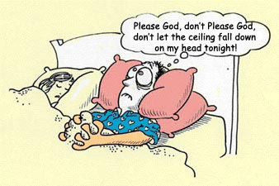
Anxiety Disorders-Classification
Marked by distressing, persistent anxiety or maladaptive behaviors that reduce anxiety
Common
Generalized Anxiety Disorder
Panic Disorder
Phobia
Obsessive Compulsive Disorder
Post-traumatic Stress Disorder

Slide 4
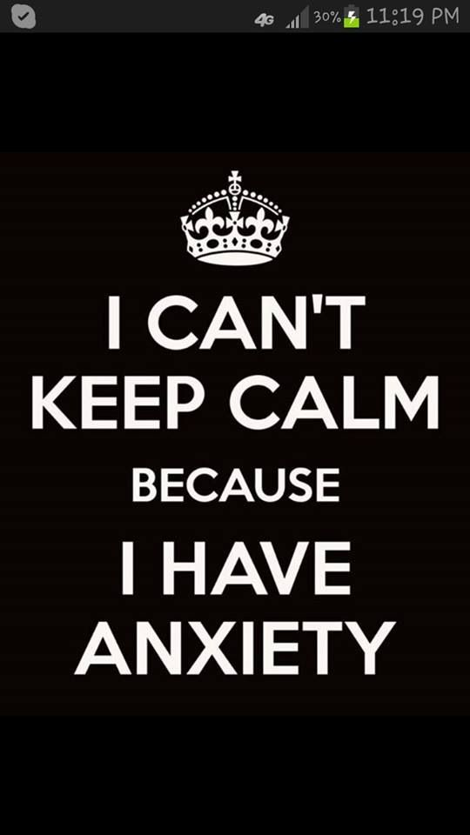
Generalized Anxiety Disorders
Person is unexplainable and continually tense, uneasy, apprehensive, and in a state of autonomic system arousal lasting at least six months
“Pathological worry”
Usually accompanied by major depressive disorder
2/3 are female

Slide 5
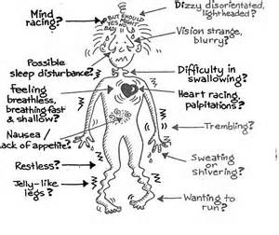
GAD Symptoms
Symptoms include jitters, agitation, sleep deprivation, dizziness, sweaty palms, heart palpitations, twitchy eyelids, perspiration, fidgeting, trembling, high blood pressure

Slide 6
GAD Treatment
Anxiety learned
Biological
Antianxiety (Xanax & Ativan)

Slide 7
Panic Disorder
Marked by unpredictable, minutes-long episodes of intense dread in which a person experiences terror and accompanying chest pains, choking, or other frightening sensations
Dizziness, trembling, shortness of breath

Slide 8
Phobia
Persistent, irrational fear marked by the avoidance of a specific object/situation
Social anxiety disorder-social situations
Agoraphobia-fear or avoidance of situations where one has felt loss of control and panic
Acrophobia-fear of heights

Slide 9
Phobia
Behavioral cause-classically or operantly conditioned/learned to fear
Biological
Amygdala activity
Genetic predisposal

Slide 10
Treatment of Phobias
Counterconditioning
Aversive conditioning=substitute a negative response for a positive response to a harmful stimulus
Exposure therapies=expose people to the things they avoid
Systematic desensitization
flooding
Virtual reality exposure therapy

Slide 11
Obsessive Compulsive Disorder
Characterized by unwanted repetitive thoughts (obsessions) and actions (compulsions)
Types of Compulsions
Hoarders
Checkers
Counters
Cleaners
videos

Slide 12
Posttraumatic Stress Disorder
Characterized by haunting memories, nightmares, social withdrawal, jumpy anxiety, numbness of feeling and/or insomnia that lingers for four weeks or more after a traumatic experience
Link to flashbulb memories
The greater one’s emotional distress during a trauma, the higher the risk for symptoms

Slide 13
Contributing Factors to PTSD
Experience severe accident, disaster, violent attack, sexual assault, wartime
Trauma
Sensitive limbic system (flooding of stress hormones)
Genetically predisposed

Slide 14
Checks!
A married woman, whose life was complicated by her mother’s living in their home, complained that she felt tense and irritable most of the time. She was apprehensive for fear that something would happen to her mother, her husband, her children, or herself. She has no definite idea what it was that she fears might happen. She suffers from occasional attacks in which her heart pounds with irregular beats; she can not seem to catch her breath when this happens. Often she breaks out in a profuse perspiration. Her mouth seems to be always dry, even though she drinks a great deal of water, and because of this and her diffuse anxiety she cannot sleep.

Slide 15
Checks!
An 11-year boy instituted the following ceremonial before going to bed. He did not sleep until he has told his mother every last minute detail of the events that occurred that day; there must be no scraps of paper or other rubbish on the carpet of the bedroom; the bed must be pushed right to the wall; three chairs must stand by it and the pillows must lie in a particular way. In order to get to sleep he must first kick out a certain number of time with both legs and then lie on his side.

Slide 16
Checks!
A 35-year-old mathematician gave a history of episodic palpitations and faintness over the previous 15 years. There had been periods of remission of up to 5 years, but in the past year the symptoms had increased and in the last few days the patient had stopped working because of the distress. His chief complaints were that at any time and without warning, he might suddenly feel that he was about to faint and fall down, or tremble and experience palpitations, and if standing would cringe and clutch at the nearest wall or chair. If he was driving a car at the time he would pull up at the curbside and wait for the feelings to pass off before he resumed his journey. He was becoming afraid of walking alone in the street or of driving his car for fear that these episodes would be triggered by it and was loath to travel by public transport. Although he felt safer when accompanied, this did not abolish his symptoms. The attacks could come on at any time of day or night.

Slide 17
Checks!
While she was on a visit to the Midwest, Samantha’s residence was demolished by a tornado. Ever since, she has been plagued by terrible nightmares and occasional flashbacks.

Slide 18
Checks!
Keshona is terrified of speaking in public. Although highly knowledgeable and competent, whenever she has to address a gathering of adults, her heart pounds, and her mouth gets dry.

Slide 19
Understanding Disorders
Psychoanalysis
Beginning in childhood, people repress conflicts into their unconscious, and the submerged mental energy produces symptoms related to anxiety
Treatment: Free association, analyze dreams, etc. to reveal unconscious conflict
unreliable

Slide 20
Understanding Disorders
Behavioral
Fears/anxiety/phobias can be conditioned (Little Albert)
Counterconditioning to remove anxiety/phobia (Mary Cover Jones and Joseph Wolpe)
Compulsive behaviors are reinforced

Slide 21
Understanding Disorders
Biological
Phobias influenced by natural selection
Compulsive acts exaggerate behaviors that contribute to survival
Genetic predisposition to fear and anxiety
Too much glutamate can make the brain overactive
Over-arousal of brain activity
Anterior cingulate cortex in OCD

