Slide 1
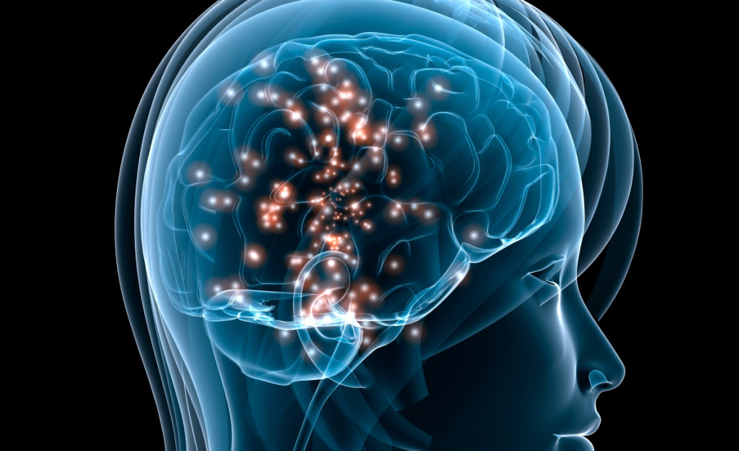
Biological Bases of Behavior Review

Slide 2
Topics in this Unit:
Neurons and Neurotransmitters
Central Nervous System and Parts of the Brain
Endocrine System (glands and hormones)
Peripheral Nervous System (somatic, autonomic, sympathetic, and parasympathetic)
Brain Plasticity, Lateralization, and Cognitive Neuroscience
Genetics
Important Psychologists

Slide 3
Resources
http://quizlet.com/6556322/unit-3-biological-bases-of-behavior-flash-cards/
Notes http://psych.wisc.edu/braun/281/Biological/BiologicalNotes.htm
Quizzes http://www.proprofs.com/quiz-school/story.php?title=biological-bases-behavior
More Quizzes http://www.learnerator.com/ap-psychology/biological-bases-of-behavior/neuroanatomy/questions/speech

Slide 4
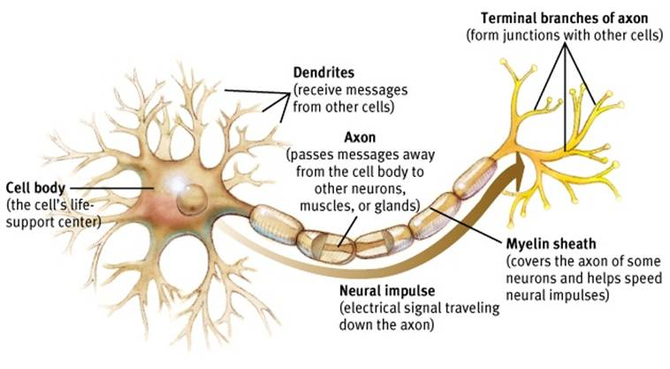
Diagram of a Neuron
Video tutorial

Slide 5
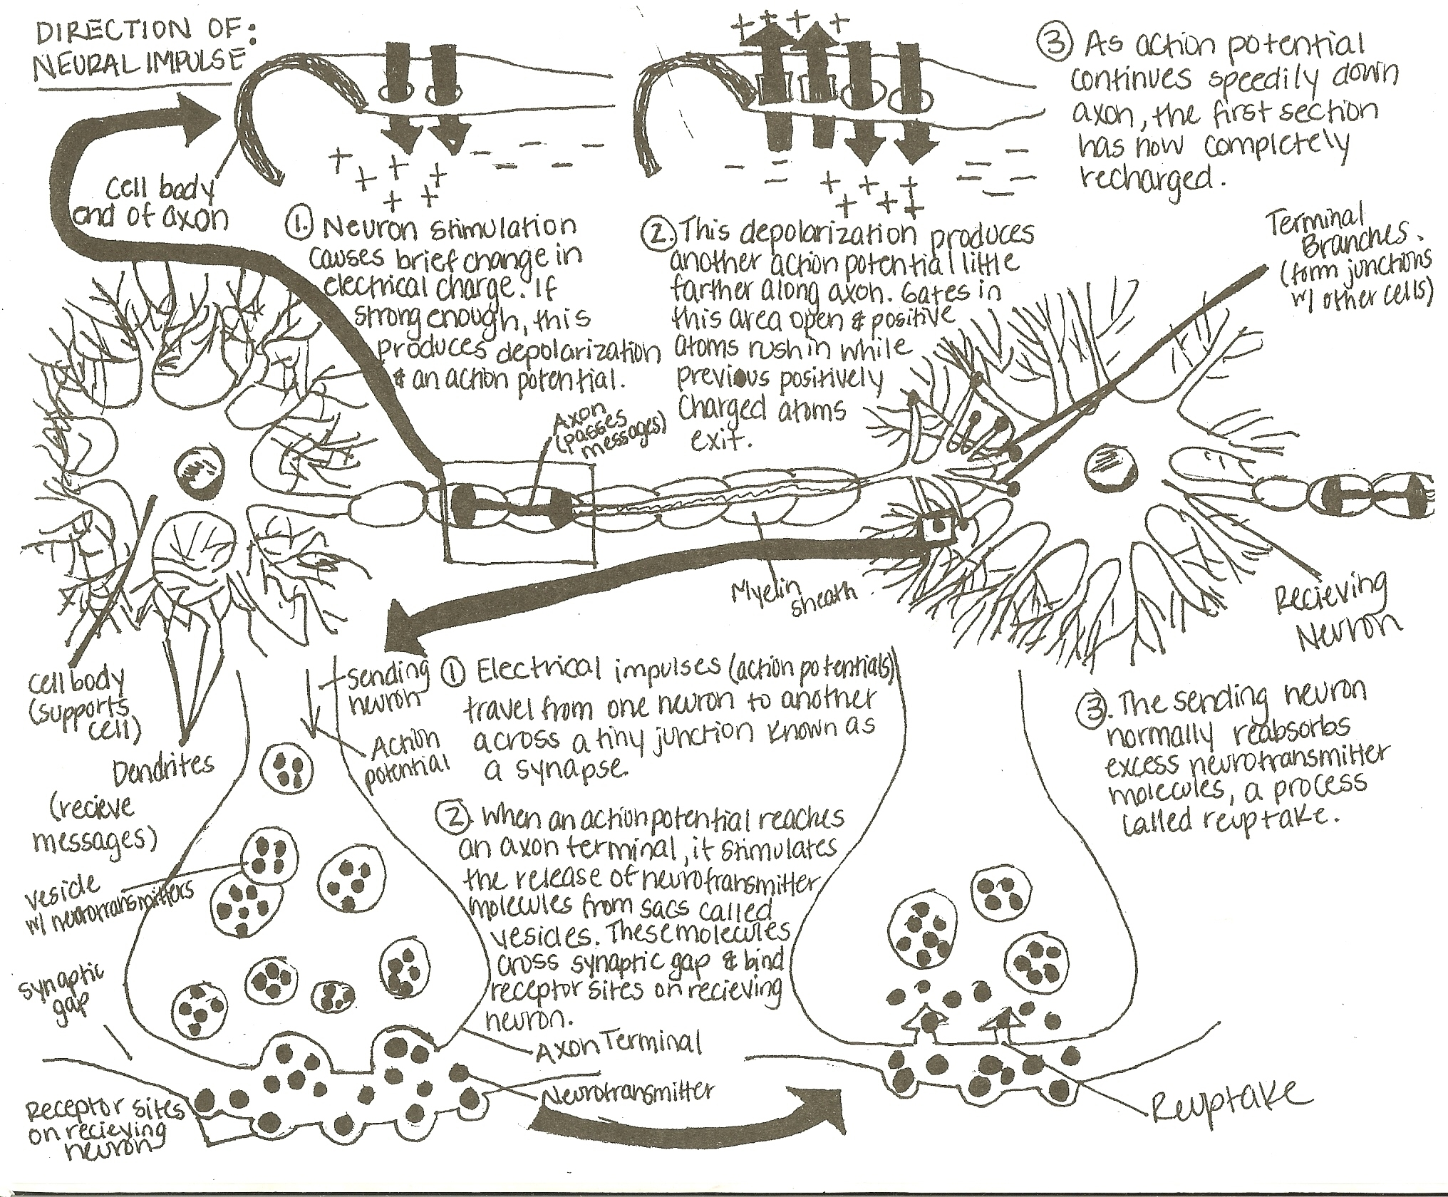

Slide 6
Neuron Definitions
Resting potential-positive ions on outside, negative ions on inside (waiting for impulse-PONI)
Action potential-brief electrical charge (impulse) traveling down an axon
Depolarization-domino effect when positive ions come in and negative ions come out, so that impulse can travel down axon
Refractory period-after impulse is done, ions get pumped back into place (positive outside and negative inside)
Threshold-minimum level of intensity needed to trigger action potential
  all or nothing response

Slide 7
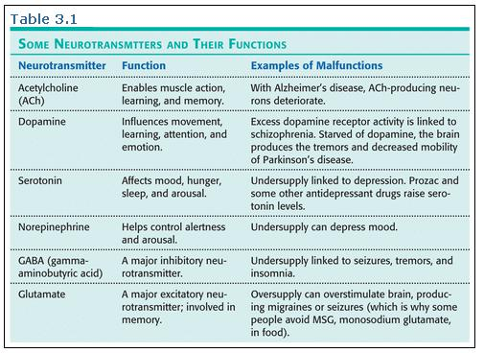

Slide 8
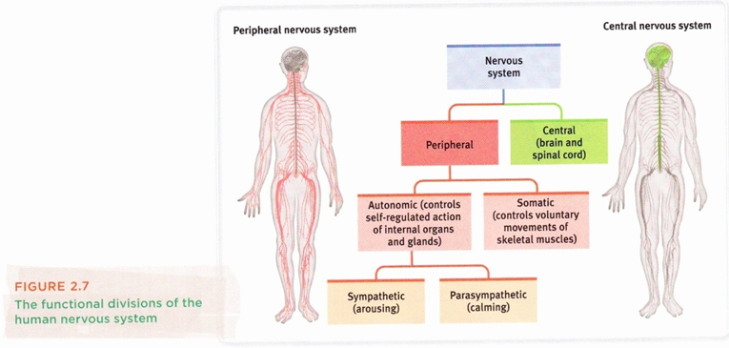
Types of Nervous Systems

Slide 9
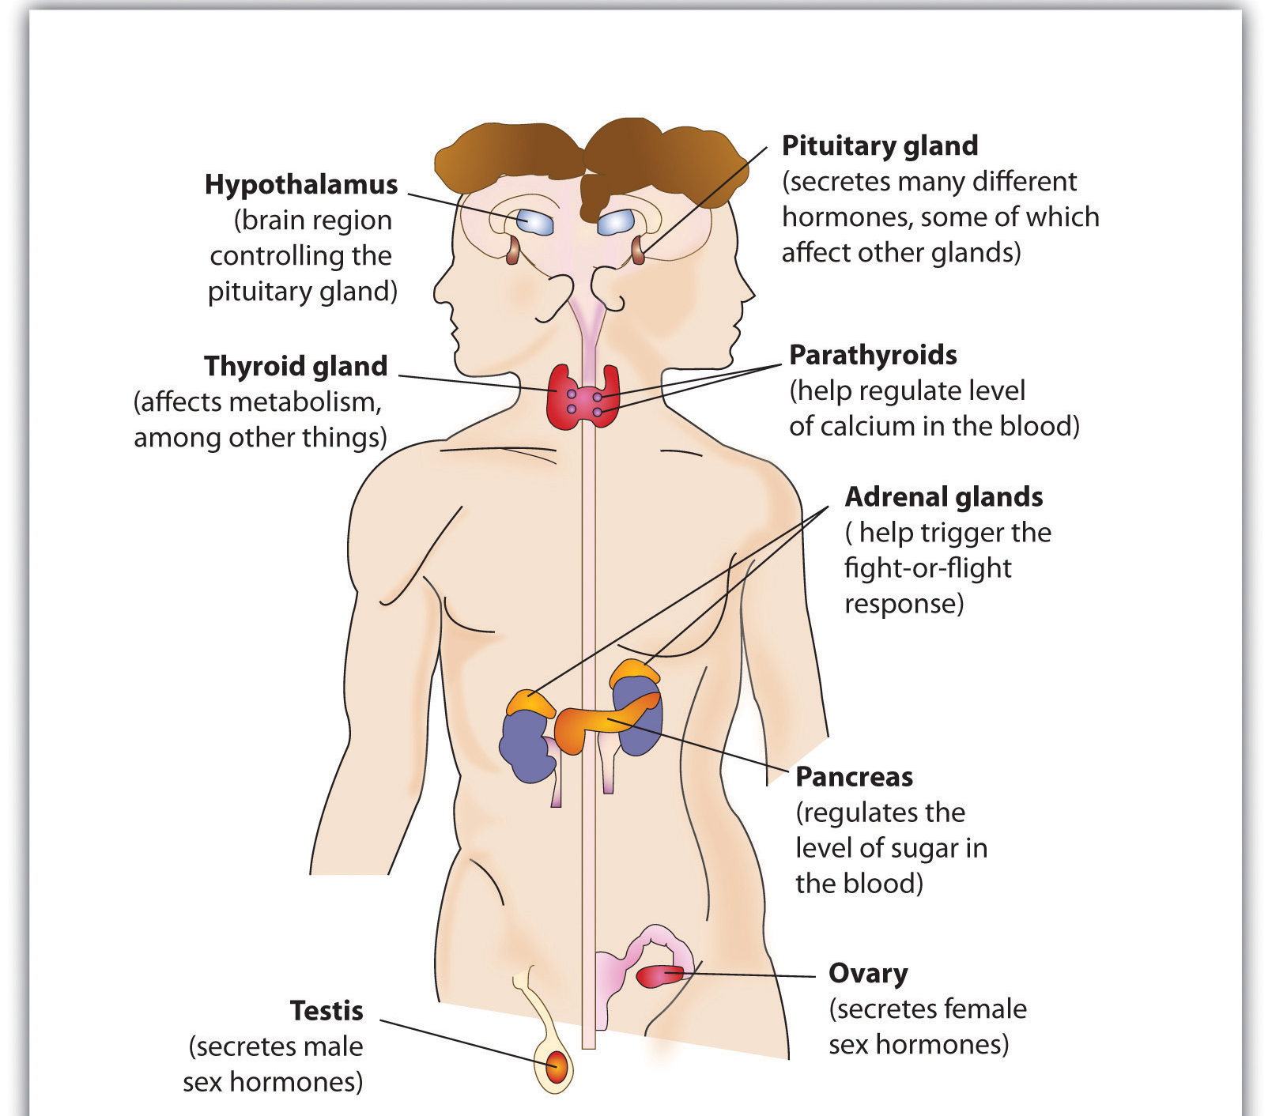
Endocrine System Diagram

Slide 10
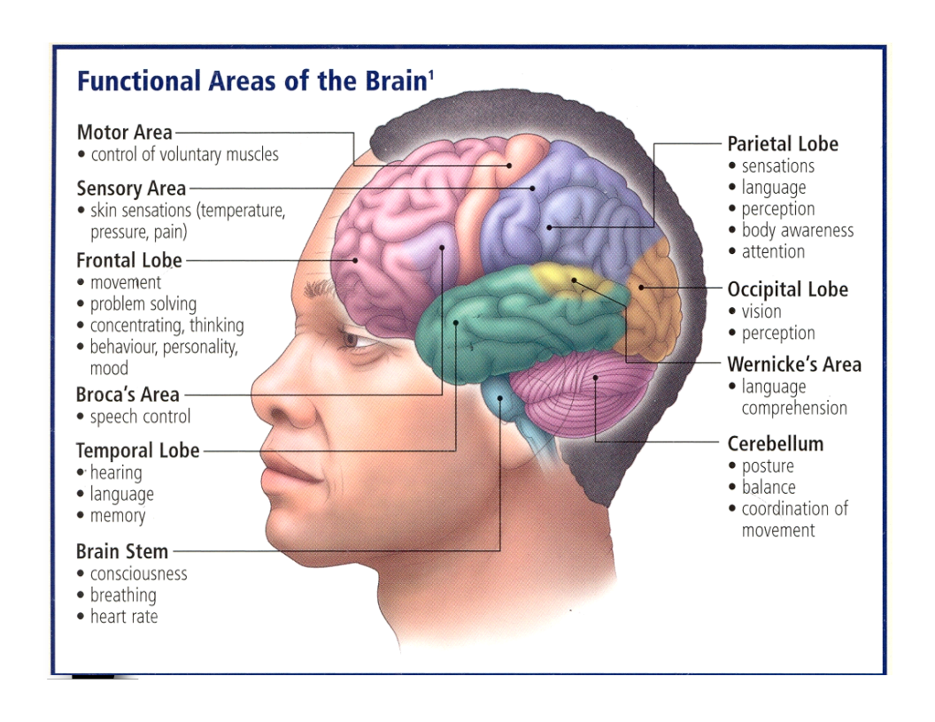

Slide 11
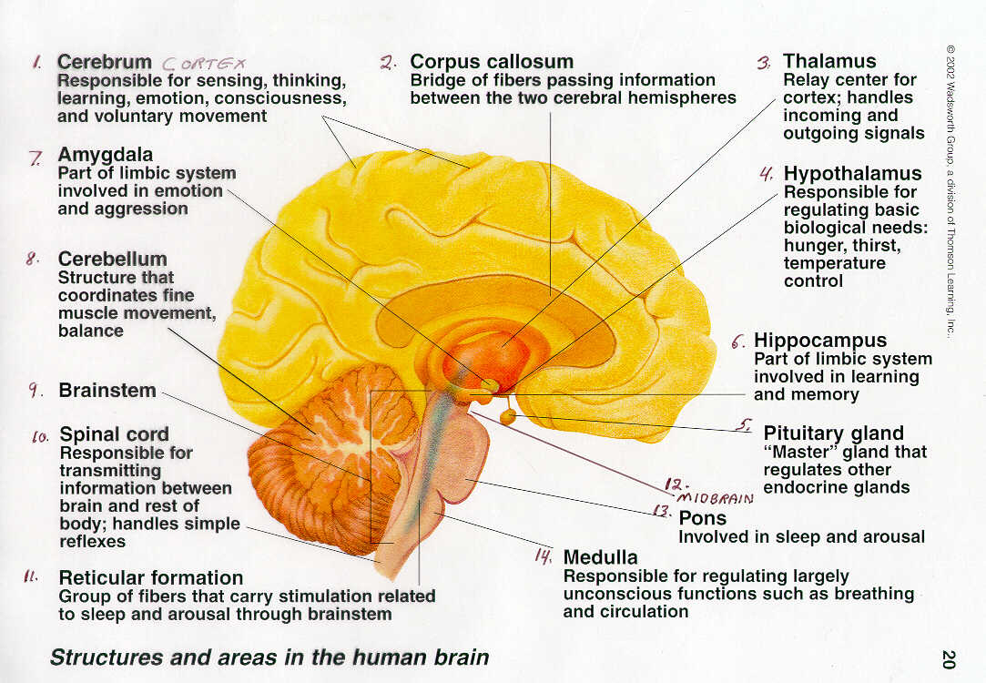

Slide 12
Brain Definitions
Plasticity-refers to a young brain’s ability to “self-heal” or recover after damage
Hemispherization/Lateralization-refers to brain’s unique left side/right side functions
Cognitive neuroscience-interdisciplinary study of the brain activity linked with our mental processes

Slide 13
Types of Brain Imaging
Electroencephalogram (EEG)-recording of brain waves showing electrical activity in brain
Computed tomography scan (CT)- shows X-ray slices of brain to detect damage
Positron emission tomography scan (PET)-displays brain activity of glucose while performing a given task
Magnetic resonance imaging (MRI)-uses magnetic fields and radio waves to produce computer generated images of soft tissue
Functional magnetic resonance imaging (fMRI)-type of MRI that reveals brain function and structure

Slide 14
Important Psychologists
Paul Broca-experiments with patient who could only say “tan;” research reveals damaged location in brain that disrupts speaking
Charles Darwin-evolution
Michael Gazzaniga-split brain research by severing corpus callosum
Roger Sperry-split brain research in cats
Carl Wernicke-revealed location in brain that disrupts understanding in language

