Slide 1
Bipolar Disorder and Schizophrenia

Slide 2
Bipolar Disorder
video
Characterized by alternation of hopelessness and lethargy of depression with the overexcited state of mania
Mania Characteristics
Overtalkative
Overactive
Elated
Little need for sleep
Low sexual inhibition
Require protection from their own poor judgment

Slide 3
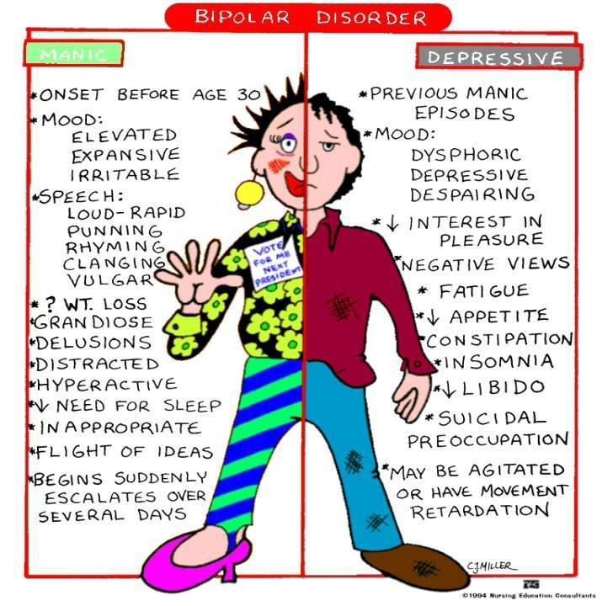

Slide 5
Factors Influencing Bipolar Disorder
Biological
Genetic predisposition (runs in families)
High heritability-80-90%
Decreased white matter and enlarged fluid filled ventricles
Increase in norepinephrine (mania) and decrease in norepinephrine (depression)

Slide 6
Treatment-Bipolar Disorder
Lithium Carbonate salt
Mood Stabilizing Drugs
Depakote (valproate)
Antipsychotics (Haldol, Risperdal, etc.)

Slide 7
Schizophrenia
Characterized by
Disturbed perceptions
Disorganized thinking and speech
Diminished or inappropriate emotions
Delusions
Hallucinations
Disorganized speech
Grossly disorganized or catatonic behaviors
Negative symptoms

Slide 8
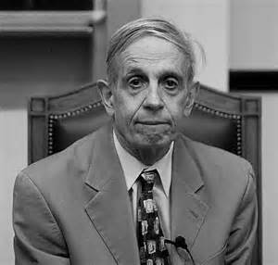
Terms
Delusions
Paranoid
Word salad
Hallucinations
Affect
Catatonia

Slide 9
Causes
Dopamine
Brain activity
Brain changes
Maternal virus during pregnancy
Genetic presdisposition

Slide 10
Bell Work
List all factors linked to the onset of schizophrenia.
How do depression and schizophrenia differ in terms of its causes and treatment?

Slide 11
Treatment
“Old Antipsychotics”
Thorazine (chlorpromazine)
Haldol (haloperidol)
Prolixin (fluphenazine)
“New Antipsychotics”
Risperdal (risperidone)
Zyprexa (olanzapine)
Clozaril (clozapine)
Seroquel (quetiapine)

Slide 12
Links
http://2.bp.blogspot.com/-UpRDpb0R3J8/UCvLvMyBlXI/AAAAAAAAJ6A/sg2T4T1WhoA/s1600/a-beautiful-mind-2001-movie-poster.jpg

