Slide 1
Bell Work
1. Do you have little brothers/sisters or cousins?
2. Have you ever tried to teach them how to do something?
How did you do this? Describe in detail.

Slide 2
Classical Conditioning

Slide 3
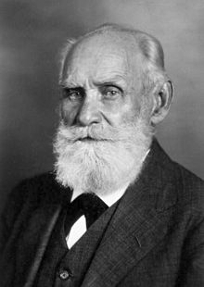
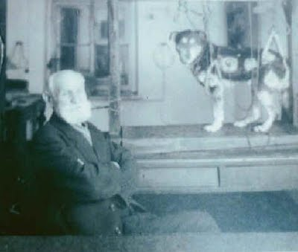
Ivan Pavlov

Slide 4
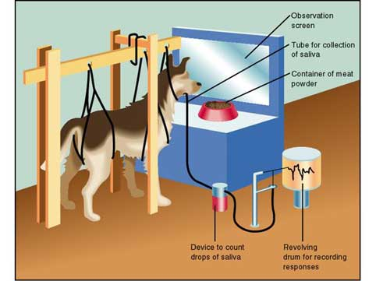

Slide 5
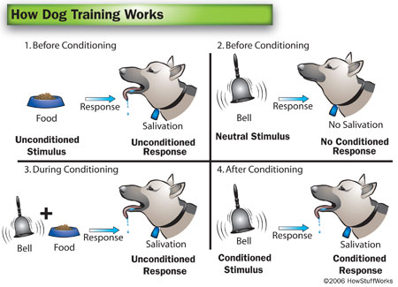

Slide 6
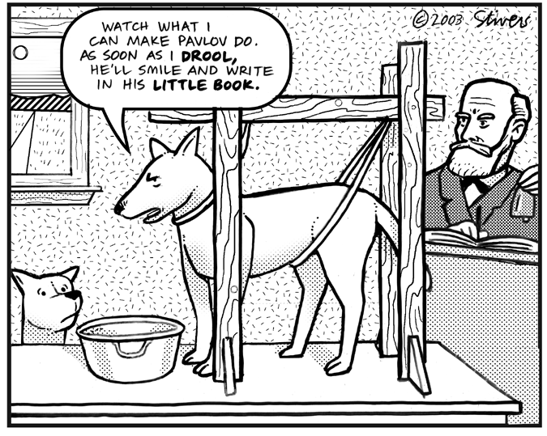

Slide 7
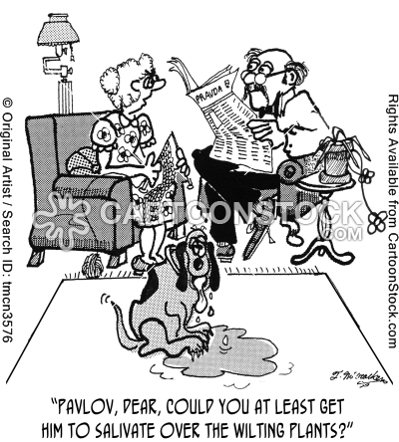

Slide 8
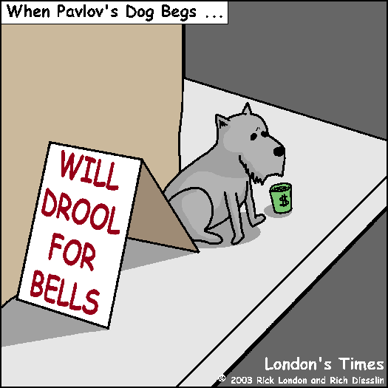

Slide 9
The Office
What is the unconditioned stimulus?
What is the unconditioned response?
What is the conditioned stimulus?
What is the conditioned response?

