Slide 1
Bell Work
Identify some behaviors exhibited by children in the following age groups. What do you think is the central focus of each age group?
Infants (0-1 years)
Toddlers (1 years-2 years)
Children ages 3-6
Children ages 6-12
Teenagers

Slide 2
Freud’s Psychosexual Stages of Development

Slide 3
Basics
Developmental periods with a characteristic sexual focus that leave their mark on an adult personality
Each stage has its own tasks, challenges, and an erogenous zone on which the stage is focused
Fixation occurs when one is unable to move forward from one stage to the next as expected
Caused by excessive gratification of needs at a stage or by excessive frustration of those needs
These fixations affect adult personality
Adult will carry emotional and psychological baggage from the earlier fixated stage

Slide 4
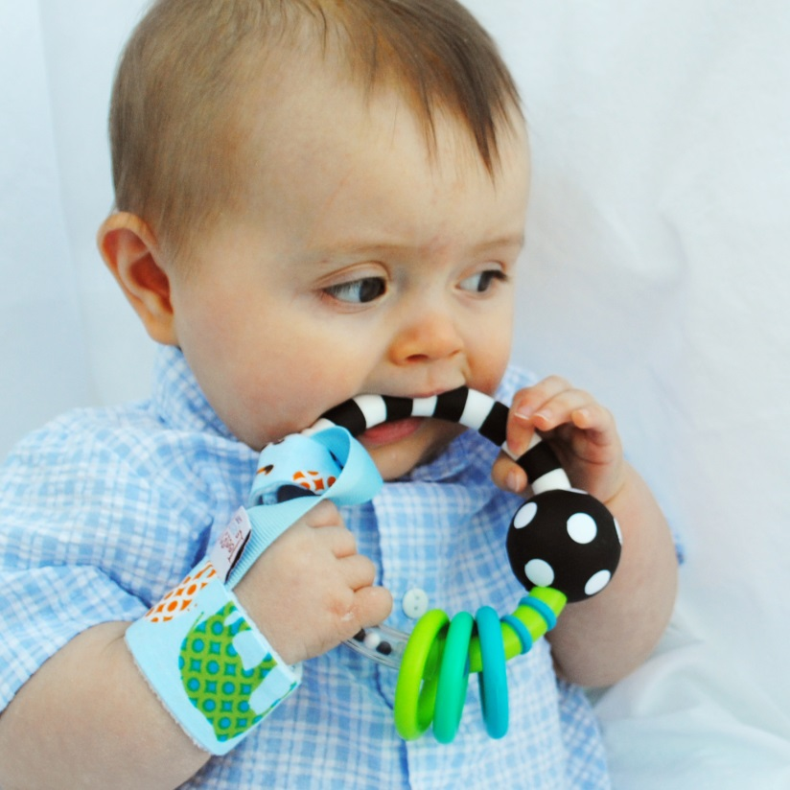
Oral Stage (First 18 months)

Slide 5
Anal Stage (18 months to 3 years)

Slide 6
Phallic stage (3-6 years)

Slide 7
Latency (6 years-Puberty)

Slide 8
Genital stage (Puberty on)

Slide 9
Group Work!
How could Freud’s stages of psychosexual development explain the development of Miley Cyrus?

Slide 10
