Slide 1
Bell Work
According to the Gestalt principle of proximity,
A. Objects that display the same features are grouped together
B. objects that are close together are interpreted as belonging together
C. monocular cues allow the size of an object to remain constant
D. binocular cues allow the color of an object to remain constant
E. objects that are farther away look as if they are moving more slowly than do closer objects
2. Which of the following would be most difficult for a person who only had one eye?
A. Inserting a toothpick into a horizontal straw
B. Watching a movie at a theatre
C. Correctly identifying the color of a car
D. Organizing objects into similar patterns or colors
E. Understanding that a line continues despite a break in it

Slide 2
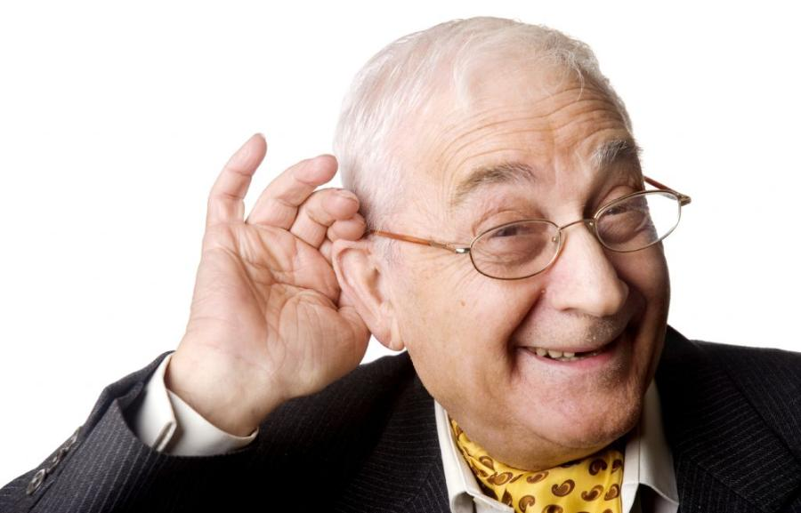
Hearing

Slide 3
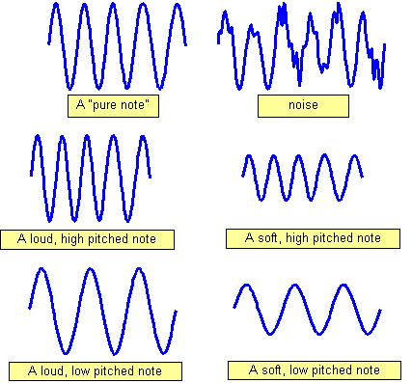
Sound Waves
Wavelength=frequency (Hz)
Determines pitch
Long waves have low frequency and low pitch
Short waves have higher frequency and high pitch
Amplitude=loudness (dB)
Sounds are measured in decibels, with zero decibels representing the absolute threshold for hearing

Slide 4
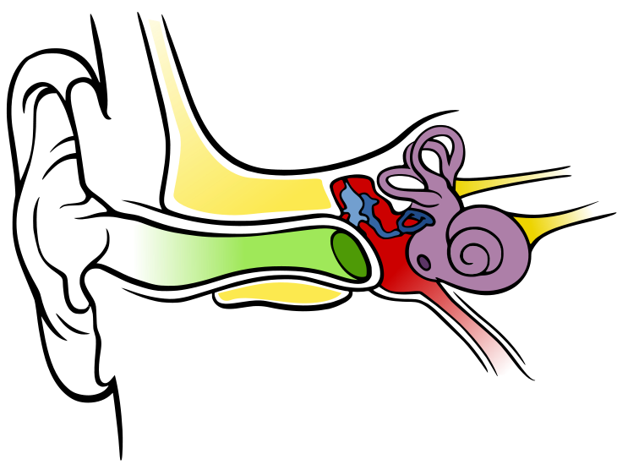
Diagram of the Ear

Slide 5
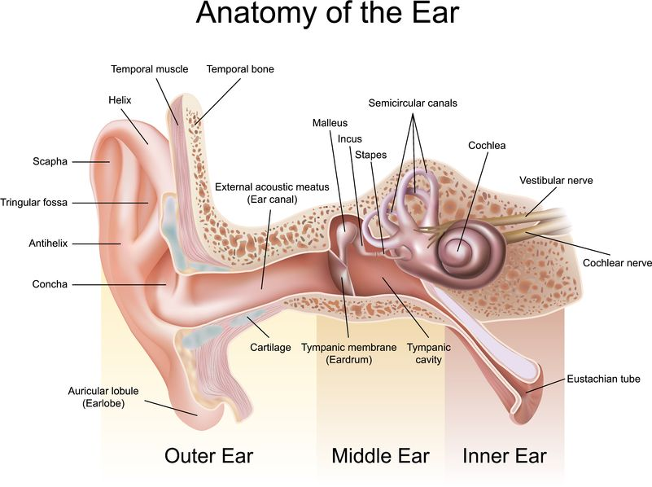

Slide 6
Hearing Loss
Sensorineural Hearing Loss
Aka nerve deafness
Damage to the cochlea’s hair cell receptors or their associated nerves
Causes: biological changes, linked to heredity, aging, prolonged exposure to ear-splitting noise
Conduction Hearing Loss
Caused by damage to the mechanical system that conducts sound waves to the cochlea
Ringing=bleeding

Slide 7
Restoring Hearing Loss
Cochlear implant
Restore hearing for people with nerve deafness
Translates sounds into electrical signals that convey info about sound to the brain
Cannot restore hearing if brain never learned how to process sound in childhood

Slide 8
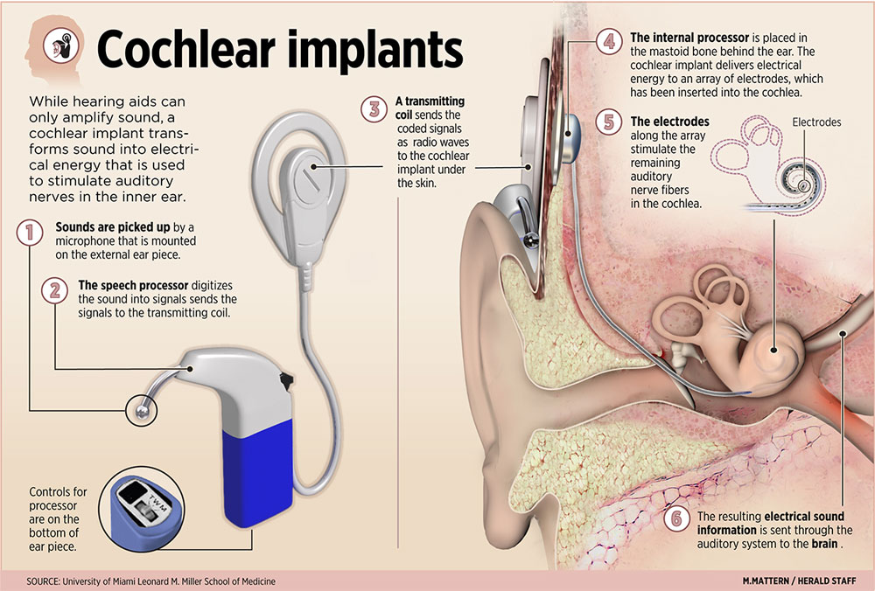

Slide 9
Perceiving Loudness
NOT from intensity of sound
From NUMBER of activated hair cells
For those with hearing loss, loud sounds still sound loud

Slide 10
Perceiving Pitch
Helmholtz’s Place Theory
Links the pitch we hear with the place where the cochlea’s basilar membrane is stimulated
Accounts for high-pitched sounds, but not low-pitched sounds
Frequency Theory
Theory that the rate of nerve impulses traveling up the auditory nerve matches the frequency of a tone
Accounts for low-pitched sounds

Slide 11
Locating Sound
Sound waves strike one ear sooner and more intensely than the other
Brain analyzes the minute differences in the two sounds and computes the sound’s source

