Slide 1
To what extent is intelligence inherited?

Slide 2
Heritability
The degree to which heredity (genetics) contributes to a trait
In this case, intelligence
Extent to which genes can explain the variation for a trait within a population
Heritability coefficient between 0 and 1

Slide 4
What evidence could support the idea that intelligence is genetic? What evidence could support the idea that intelligence is learned/environmental?

Slide 5
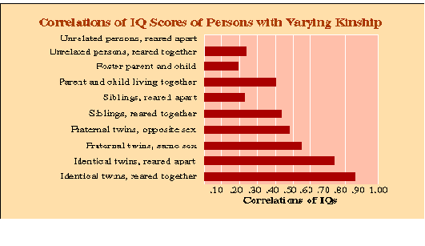

Slide 6
Fun Facts
Intelligence correlations between biological parents and children increases with age.
Malnutrition, impoverished environmental conditions, etc. can depress cognitive development
Enriched environments do not increase cognitive abilities
Baby Einstein and Mozart do not improve intellectual development in children
Carol Dweck: efforts should be taken to increase intelligence

