Slide 1
Intelligence Tests

Slide 2
Psychological Tests
Mental abilities test
Intelligence Test
Aptitude Test
Achievement Test
What do you think it means when we say that the STAAR test is standardized??

Slide 3
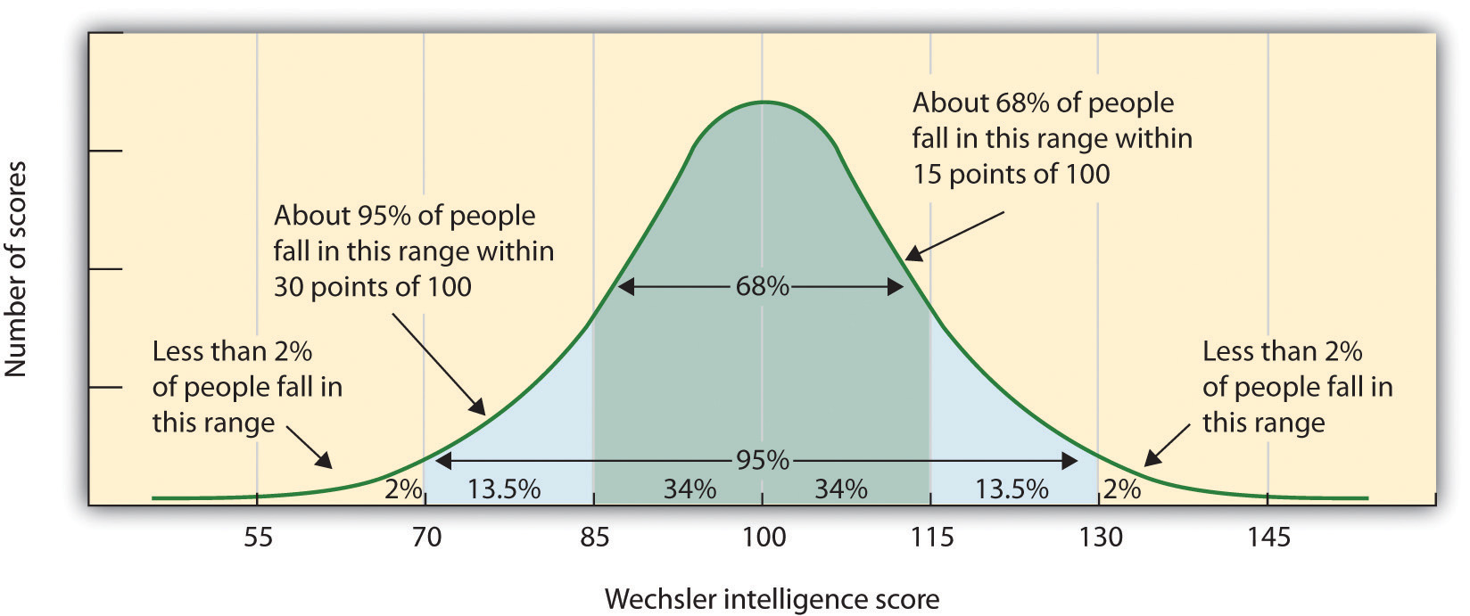
Standardization
Uniform procedures
Norms

Slide 4
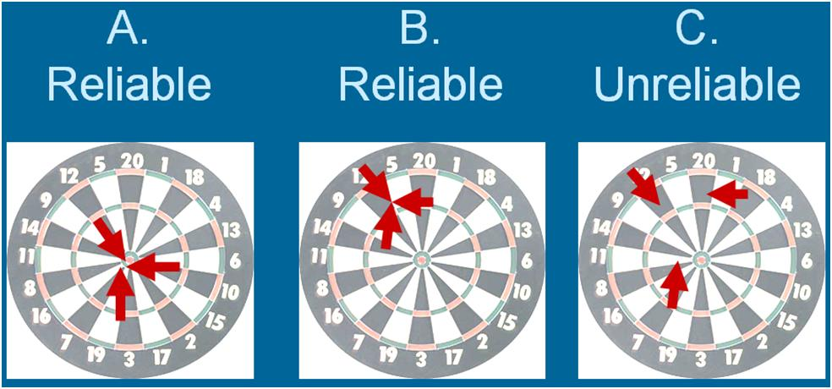
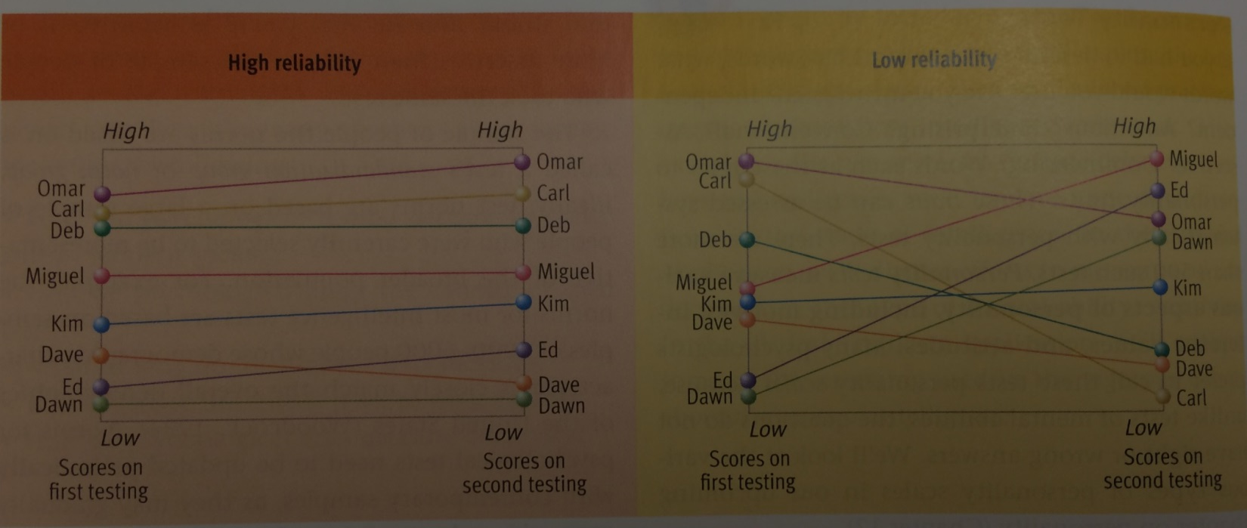
Reliability
Consistency
Test-retest
Split-half/split-test

Slide 5
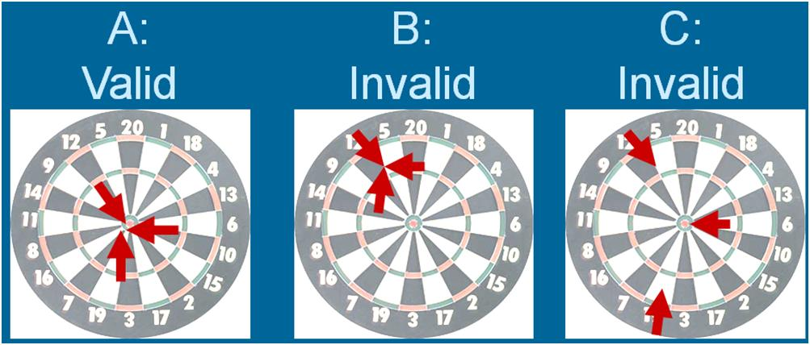
Validity
Measures what is supposed to be measured

Slide 6
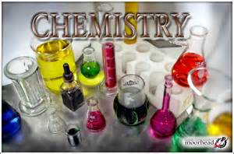
Content Validity

Slide 7
Criterion-Related Validity

Slide 8
Construct Validity

Slide 9
Check
At the request of the HiTech computer store chain, Professor John develops a test to measure aptitude for selling computers. Two hundred applicants for sales jobs at HiTech stores are asked to take the test on two occasions, a few weeks apart. A correlation of + .82 is found between the applicants’ scores on the two administrations o f the test. This, the test appears to possess reasonable ____________.
Test-retest reliability

Slide 10
Check
All 200 of these applicants are hired and put to work selling computers. After six months Professor John correlates the new workers’ aptitude test scores with the dollar value of the computers that each sold during the first six months on the job. This correlation turns out to be -.21. This finding suggests that the test may lack _______________.
Criterion-related (predictive) validity

Slide 11
Check
Back at the university, Professor John is teaching a course in theories of personality. He decides to use the same midterm exam that he gave last year, even though the exam includes questions about theorists that he did not cover or assign reading on this year. There are reasons to doubt the ___________ of Professor John’s midterm exam.
Content validity

Slide 12
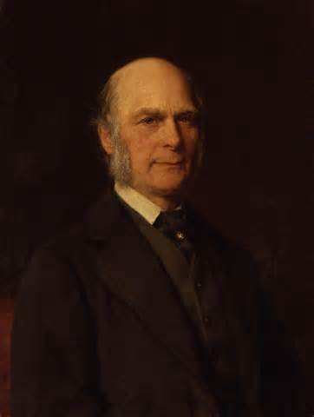
Sir Francis Galton
Intelligence is genetically inherited
Nature v. nurture
Creates an interest in the measurement of mental ability
What did Galton’s tests lack?

Slide 13
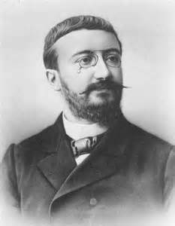
Alfred Binet
French school children
Mental age

Slide 14
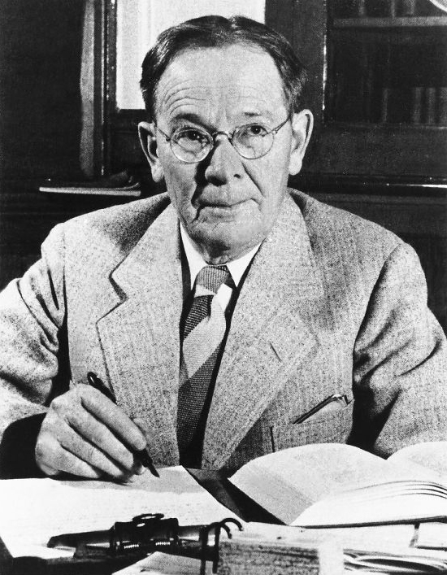
Lewis Terman
Stanford-Binet
William Stern’s “intelligence quotient”
Mental age/chronological age x 100
Terman’s termites

Slide 15
IQ Practice
Mental age of 15
Chronological age of 10
IQ?
Mental age of 8
Chronological age of 5
IQ?

Slide 16
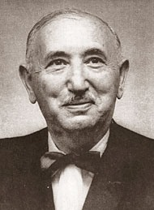
David Wechsler
Wechsler Adult Intelligence Scale
Raymond Cattell
Fluid vs. crystallized intelligence

Slide 18
Check-Who is it?
On the basis of a study of eminence and success in families, this theorist concluded that intelligence is inherited. He also invented the concept of correlation and coined the phrase nature v. nurture.
Sir Francis Galton

Slide 19
Check-Who is it?
This person’s theory takes a cognitive approach to intelligence. He argues that there are three key facets of human intelligence: analytical, creative, and practical intelligence.
Robert Sternberg

Slide 20
Check-Who is it?
This psychologist developed the Stanford-Binet Intelligence Scale, which originally described children’s scores in terms of an intelligence quotient.
Lewis Terman

Slide 21
Check-Who is it?
This French psychologist devised the first successful intelligence test, which expressed a child’s score in terms of mental age.
Alfred Binet

Slide 22
Check-Who is it?
This person developed the first influential intelligence test designed specifically for adults. He also discarded the intelligence quotient in favor of a scoring scheme based on the normal distribution.
David Wechsler

Slide 23
Check-Who is it?
His research helped lend support to the idea of fluid intelligence and crystalized intelligence as sub-divisions of g.
Raymond Cattell

Slide 24
Check-Who is it?
This theorist argued that there are eight types of intelligence.
Howard Gardner

Slide 25
Check-Who is it?
This theorist concluded that all cognitive abilities share an important core factor. He labeled this factor g for general mental ability.
Charles Spearman

