Slide 1
Introduction to Psychological Disorders

Slide 2
Anchor Chart
On a piece of butcher paper, write the following:
1. your notions of what a psychological disorder is
2. background/pre-existing knowledge that you have about disorders
3. Stereotypes about psychological disorders
4. questions that you have about psychological disorders

Slide 3
Disclaimer
NONE of us are doctors, and therefore, we cannot make assumptions about a person’s mental state.
Avoid generalizing information about psychological disorders to yourself and “self-diagnosing”—this is called intern’s syndrome.
A patient is a PERSON first, not an illness, or “crazy,” “retarded,” etc.

Slide 4
What makes a psychological disorder?
Atypical
Disturbing
Maladaptive
Unjustifiable
Insane??

Slide 5
Is it abnormal?
Hissing
Not in Japanese culture where it is used to politely respect superiors
Engage in homosexual behavior before marriage
Not among the Karaki tribe of New Guinea, where the opposite is considered abnormal
Using straws
considered vulgar in Thailand
Men holding hands
Not in Thailand where this is a sign of friendship

Slide 6
Who is Ill?
Thomas counts everything in sets of four. He does this while brushing his teeth, doing his homework, eating his cereal or watching television. Thomas counts both out loud and internally depending on the situation. He is currently failing out of school because he devotes so much of his time to counting.

Slide 7
Who is Ill?
George works on the thirty-third floor of the John Hancock building in an accounting firm. He does not like going up into high places and often holds his breath on the elevator ride to his office. His cubicle is located in the center of the office, which is a benefit to him because he does not have to look out the windows at work. His work is accurate and once he is at his desk, he feels comfortable.

Slide 8
Who is ill?
Aki loves anime cartoons, figures, and cards and is actively engaged in an online anime community. She often spends hours each day engaged in some type of anime activity. Most of her friends are involved in anime and she often talks of this topic at lunch and during her free periods at school.

Slide 9
Who is ill?
Shana sometimes hears voices in her head that narrate her life. She cannot determine when they will be present of when they will stop. She cannot distinguish these voices from her internal thought processes or sometimes even external conversations.

Slide 10
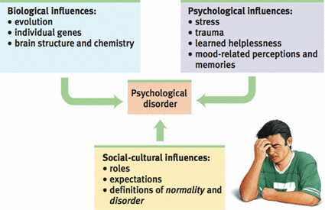
Historical and Contemporary Approaches to Disorders
Alienation
(trephination, exorcism, etc.)
Medical Model
Biopsychosocial Approach
Philippe Pinel
Dorothea Dix

Slide 11
Classifying Disorders
Diagnostic and Statistical Manual of Mental Disorders, 5th Edition

Slide 12
Labeling
David Rosenhan’s 1973 study

