Slide 1
Learning

Slide 2
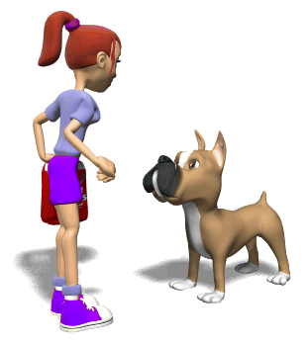
Topics in this Unit
Classical Conditioning
Operant Conditioning
Learning by Observation
Important Psychologists
Behaviorism

Slide 3
Classical Conditioning
Type of learning in which one learns to link two or more stimuli and anticipate events
Ivan Pavlov
John B. Watson
Tutorial

Slide 4
Classical Conditioning
Start with something that happens NATURALLY
UNCONDITIONED STIMULUS
UNCONDITIONED Response
When I exercise,
I get sweaty.

Slide 5
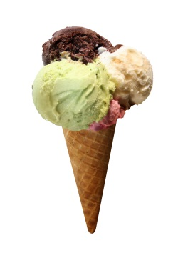
Classical Conditioning
Now, let’s try to train myself to sweat when see ice cream.
Do this several times
Neutral stimulus=has no effect on me sweating at first

Slide 6
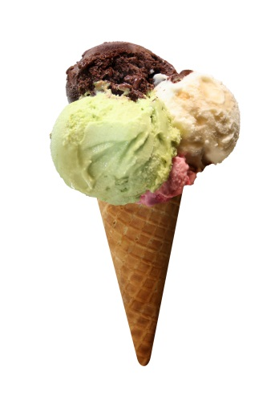
Classical Conditioning
Now, when I see ice cream, I sweat.
CONDITIONED STIMULUS
CONDITIONED Response

Slide 7
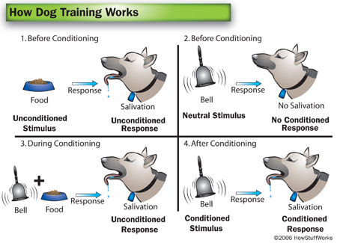

Slide 8
Classical Conditioning Terms
Acquisition-stage of initial learning
Higher ordering conditioning-adding a second (usually weaker) conditioned stimulus (light, tone, bell)
Extinction-diminishing response when CS no longer signals response
Spontaneous recovery-reappearance of CR after a pause
Generalization-tendency to respond to similar stimuli
Discrimination-learned ability to distinguish between a conditioned stimulus and other irrelevant stimuli
Learned helplessness-hopelessness and passive resignation one learns when unable to avoid repeated aversive events

Slide 9
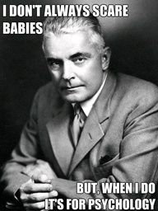
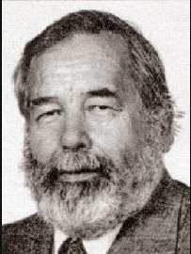
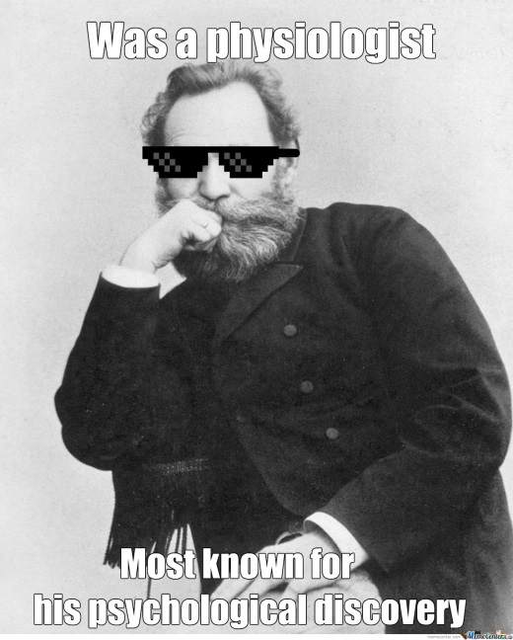
Classical Conditioning Applications
John B. Watson-Little Albert experiment
Ivan Pavlov-Dogs salivating
John Garcia-taste aversions
Learning enables animals to adapt to their environments

Slide 10
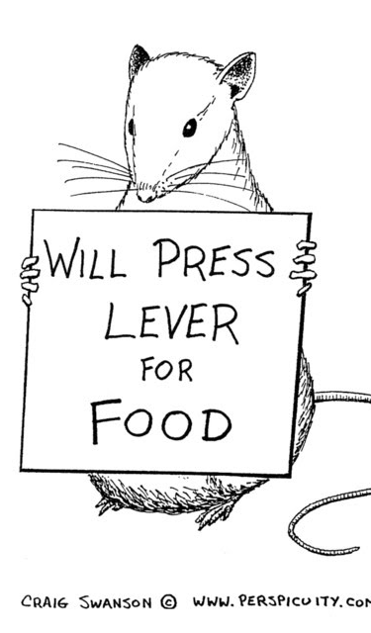
Operant Conditioning
Type of learning in which behaviors are strengthened with reinforcement or diminished with punishment
Thorndike’s law of effect-behaviors followed by favorable consequence will be more likely to occur and by unfavorable consequence will be less likely to occur

Slide 11
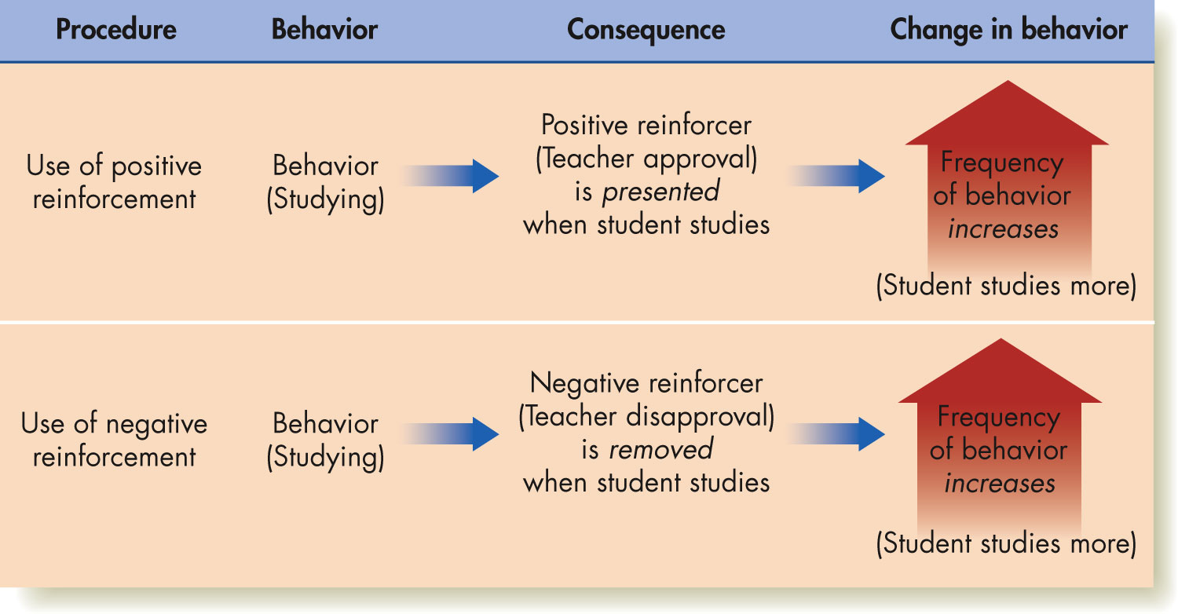
Reinforcement
Any event that strengthens the behavior it follows

Slide 12
Schedules of Reinforcement

Slide 15
Schedules of Reinforcement Practice
Giving food to a rat when it presses a bar five times
Fixed-ratio
Giving food to a rat when it presses a bar one time, then five times, then three times, etc.
Variable-ratio
Giving food to a rat when it presses a bar every 30 seconds
Fixed-interval
Giving food to a rat when it presses a bar after five minutes, then three minutes, then one minute, etc.
Variable-interval

Slide 16
Punishment
Positive punishment
NEGATIVE punishment

Slide 17
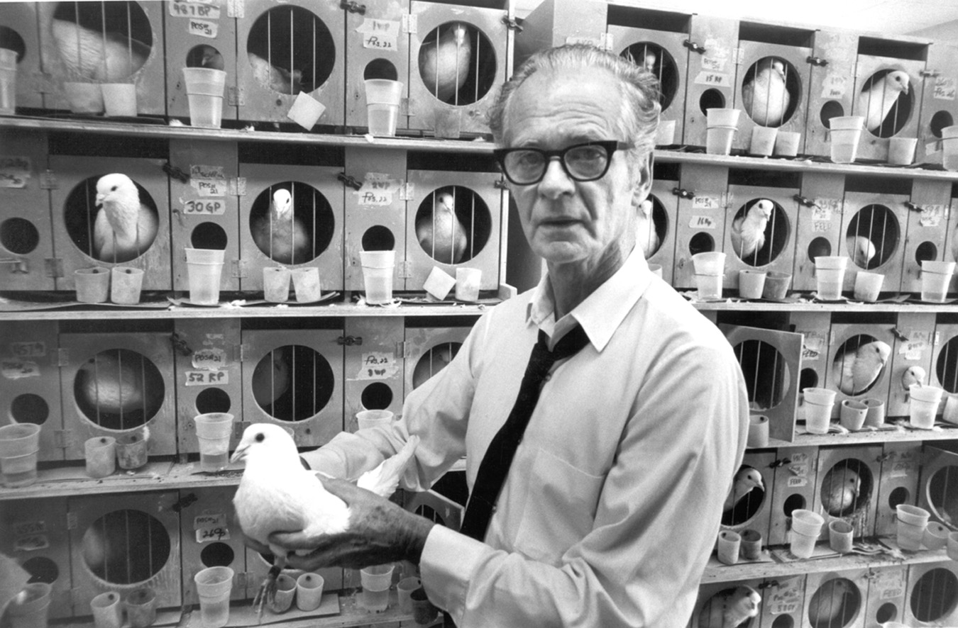
Operant Conditioning Application
B.F. Skinner-pigeons in a box
Shaping

Slide 18
Comparing Classical and Operant

Slide 19
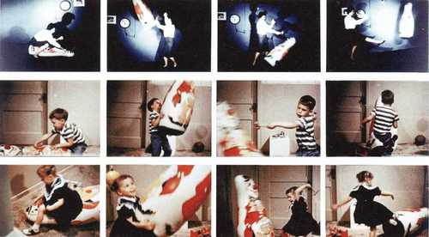
Learning by Observation
Modeling-”monkey see, monkey do”
Albert Bandura and the Bobo doll experiment

Slide 20
Resources
http://quizlet.com/16622322/mr-meyers-ap-psych-unit-6-learning-vocab-flash-cards/
https://www.learnerator.com/ap-psychology
http://www.apstudynotes.org/psychology/outlines/chapter-6-learning/
http://www.youtube.com/watch?v=nMGRck-fVJ0

