Slide 1
Mood-Related Disorders
***Now considered Depressive Disorders and Bipolar Disorders***

Slide 2
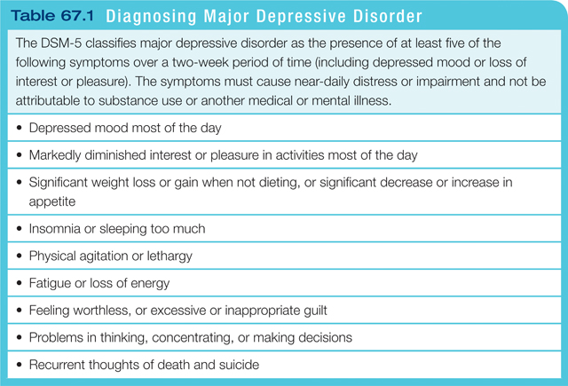
Major Depressive Disorder

