Slide 1
Bell Work
Where are dendrites, and what is their function?
Attached to the soma; to receive chemical messages
Where is the axon, and what is its function?
In between the soma and the terminal ends; to pass messages
What are neurotransmitters, and what is their function?
In sacs or vesicles within the terminal bulb; they are chemical messengers that are released and trigger a neural impulse in a neighboring neuron

Slide 2
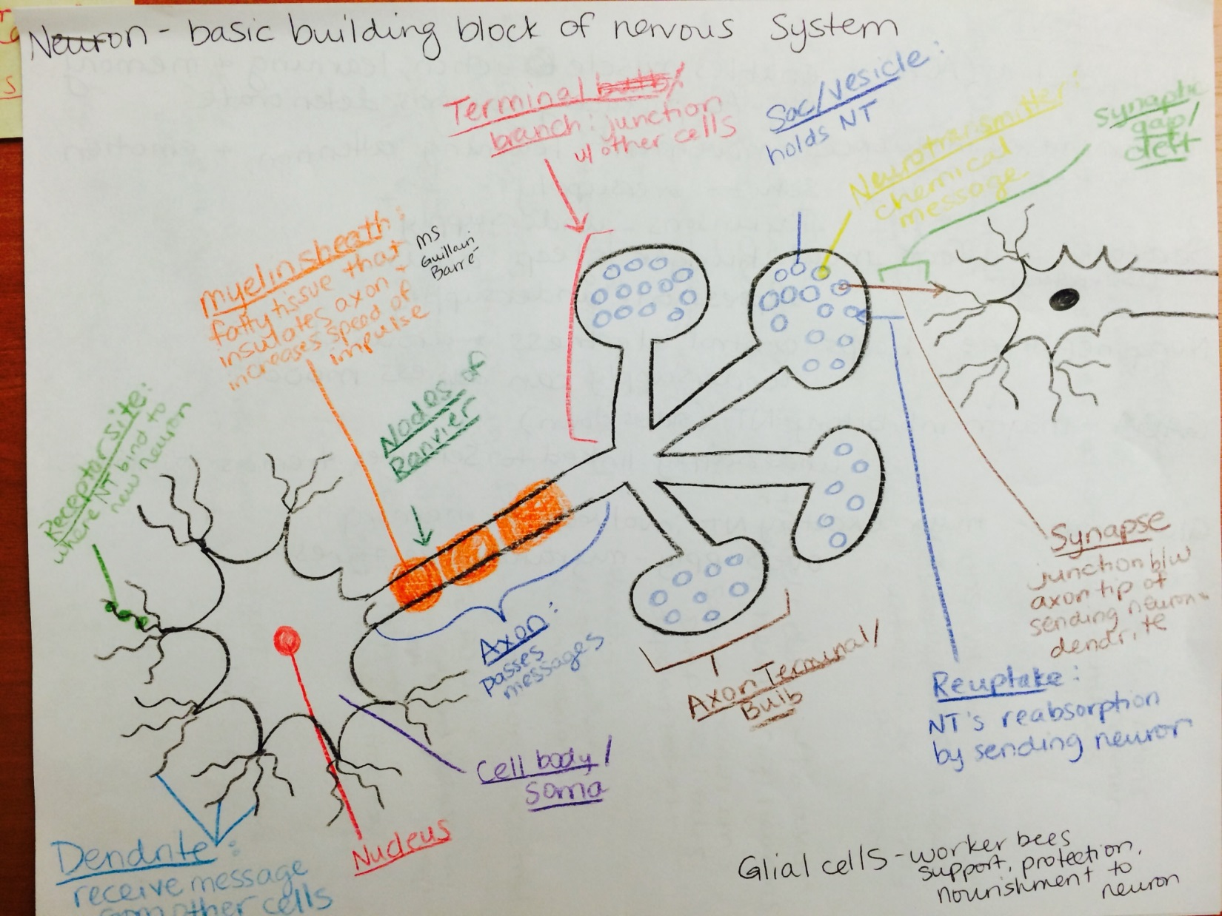

Slide 3
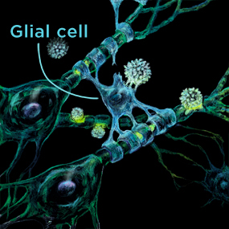
Glial Cells (Neuroglia)
Cells that provide support, protection, and nourishment to the neurons
Types
Oligodendroglia
Schwann cells
Astrocytes

Slide 4
Resting Potential

Slide 5
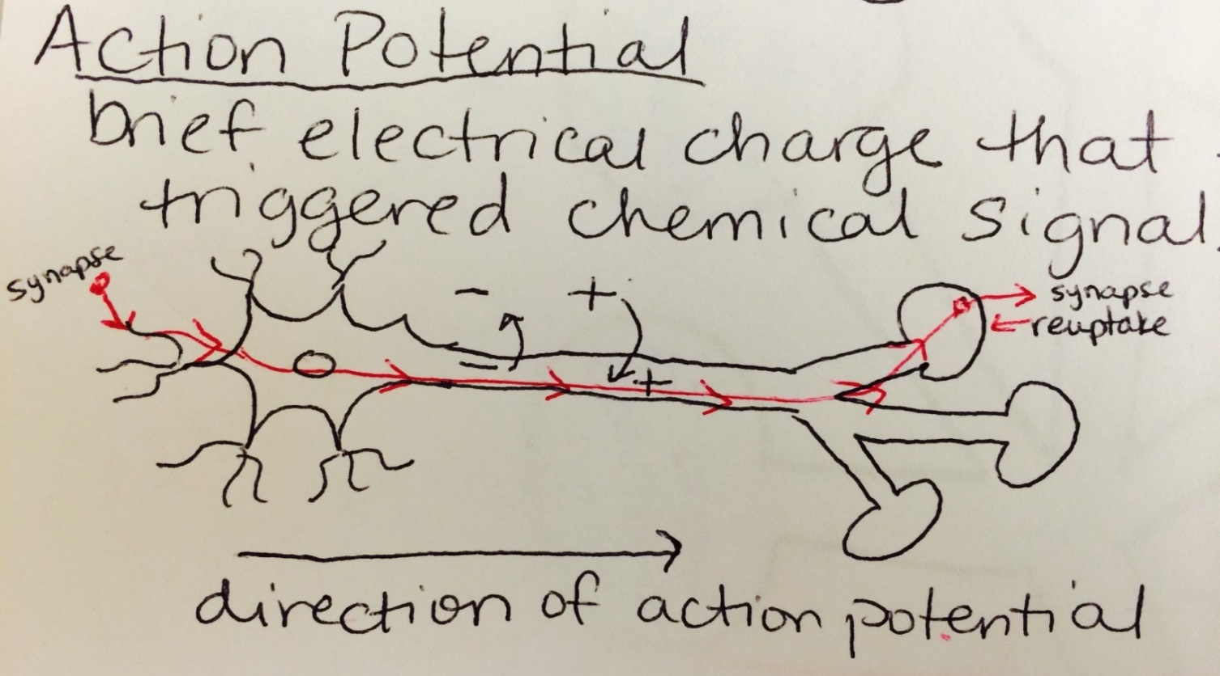
Action Potential
Brief, electrical charge that travels down the axon triggered by chemical signals from neighboring neurons

Slide 6
Refractory Period

Slide 7
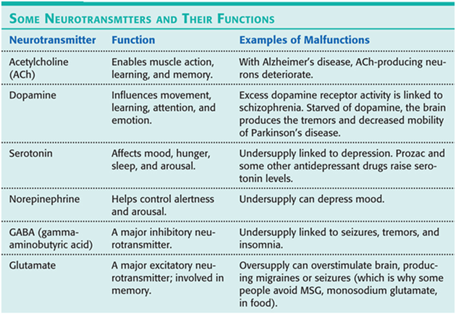
Types of Neurotransmitters

Slide 8
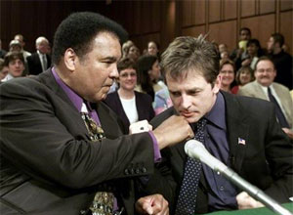
Undersupply of Dopamine=Parkinson’s
Muhammed Ali and Michael J. Fox

Slide 9
Undersupply of Serotonin=Depression
In a normal person…

Slide 10
Undersupply of Serotonin=Depression
In a depressed person…

Slide 11
Undersupply of Serotonin=Depression
With SSRIs (Selective Serotonin Reuptake Inhibitors) like Prozac…

Slide 12
Here is a good video
https://www.youtube.com/watch?v=-9xBfvh7hgg
Sorry I missed class!!
By the way, please know what agonists and antagonists are, as well as endorphins!!
After the video, complete the Neuron HW
I will be in Mr. Garner’s homeroom today to go over any confusing material.

