Slide 1
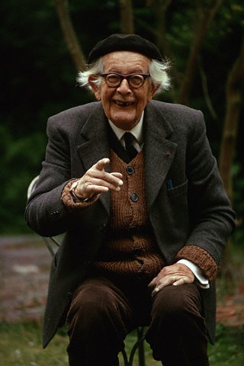
Piaget’s Stages of Cognitive Development

Slide 2
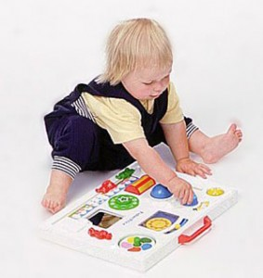
Sensorimotor Stage (Birth-Age 2)
Infants develop the ability to coordinate their sensory input with their motor actions
Primary circular reactions
Secondary circular reactions
Tertiary circular reactions
Shift from innate reflexes to mental symbols
Gradually understand object permanence
Direct groping

Slide 3
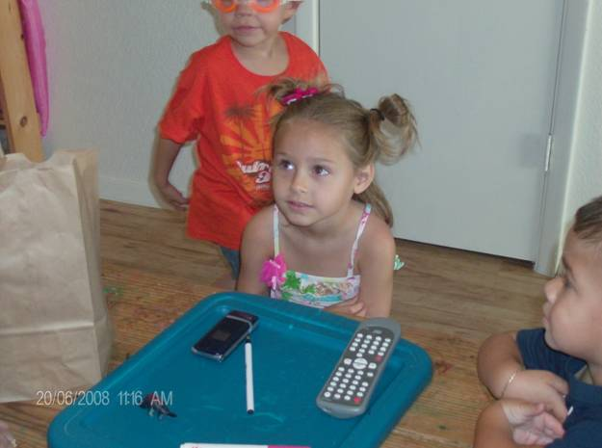
Preoperational Stage (ages 2-7)
Increased ability to think symbolically and logically
Not mastered conservation (awareness that physical quantities remain constant in spite of changes in shape or appearance)
Number, mass, length, area, volume
Centration-focus on one feature of a problem, not the whole/other aspects
Irreversibility-inability to envision reversing an action

Slide 4
Preoperational Stage (ages 2-7)
Egocentrism-inability to share another person’s point of view
Animism-belief that all things are living
Artificialism-natural phenomena are created by people
Collective monologues-conversations between children who are talking about two different subjects
Video of 4 year old and 2 year old-Egocentrism and Animism

Slide 5
Concrete Operational (ages 6/7-11)
Begin to think logically about concrete events
Master conservation (gradually), reversibility, and decentration
Can work successfully with hierarchical classifications
Comprehend mathematical transformations
Unable to deal with abstract concepts

Slide 6
Formal Operational (begins around 12)
Apply mental operations to abstract concepts
Think logically
http://www.youtube.com/watch?v=zjJdcXA1KH8

Slide 7
Evaluate the accuracy of Piaget’s theory…

Slide 8
Assessing Piaget’s Theory
Lev Vygotsky: Children learn best by interacting with others
Language can help build thinking
Scaffolding
Zone of proximal development

Slide 9
Language Development
Cooing (2 months)-babies begin to make vowel sounds
Babbling (6 months)-add consonant sounds to vowel sounds
Holographic speech (age 1)-say actual words or use holophrases, such as “milk!”
Telegraphic speech (age 18 months)-string words together to form short, simple sentences, ex. “Mommy, go”
Whole sentences (age 6) – use grammar, increase vocabulary, etc.

Slide 10
Assessing Piaget’s Theory
Continuity & Stages
Did Piaget miss certain conceptual abilities?
Importance and scope of logic, language, and culture
Age at which object permanence, conservation, etc. occur

