Slide 1
Prenatal Development and Physical Development

Slide 2
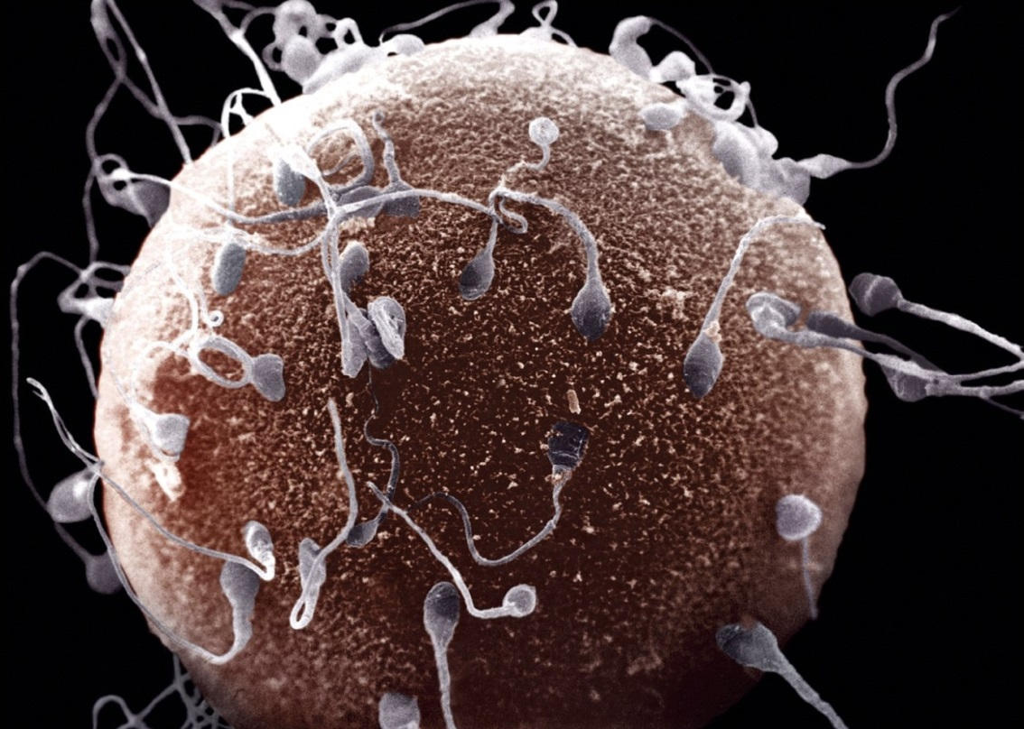
Prenatal Development-Germinal Stage
First 2 weeks after fertilization and conception
Zygote
Fewer than half survive
Cell division and differentiation
Implants onto placenta after 10 days

Slide 3
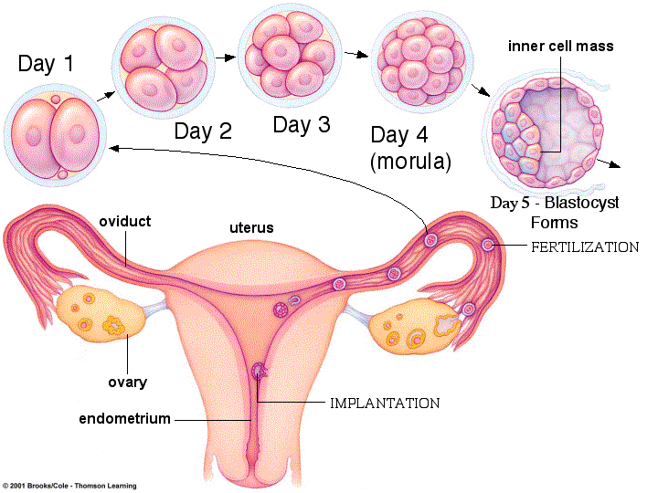

Slide 4
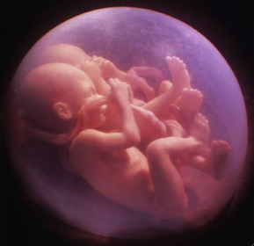
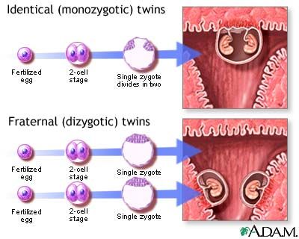
Twins
Monozygotic twins
“Identical”
Two babies come from one zygote that split completely into two separate masses
Same sex and possess the same set of 46 chromosomes
Dizygotic twins
“Fraternal”
Two babies come from two zygotes (two eggs were released during ovulation and fertilized by two different sperm cells)

Slide 5
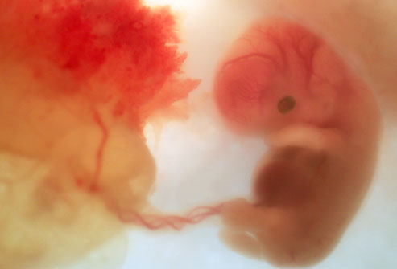
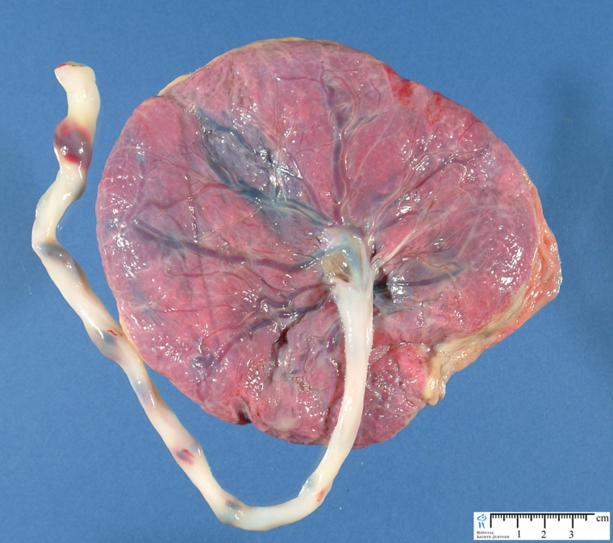
Embryonic Stage
Lasts from two weeks after conception to 8-10 weeks
Inner cells of the zygote become the embryo
Outer cells become the placenta
Organs begin to form and function (heart, spine, brain)

Slide 6
Embryonic Stage
This is a stage of great vulnerability, because virtually all the basic physiological structures are forming.
What type of outside (environmental) forces could affect the embryo at this stage?

Slide 7
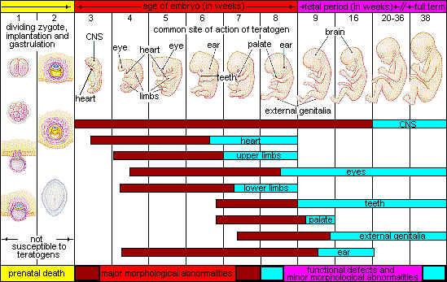
Teratogens
External agents that can harm an embryo or fetus

Slide 9
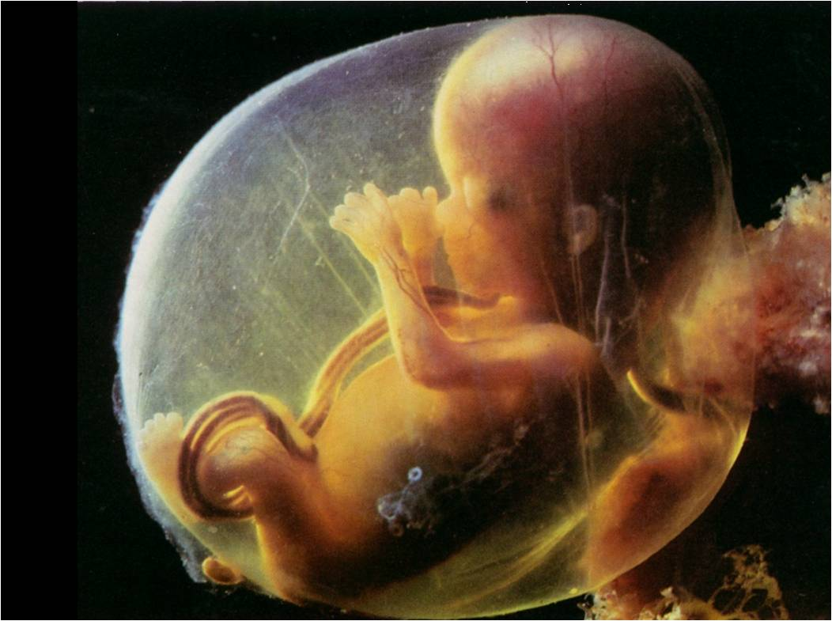
Fetal Period
8-10 weeks (2 months) to 40 weeks (9 months)
Organs continue to develop and become functional
Teratogens will affect the physical functioning not the structure
22-26 weeks is the threshold of viability
http://www.webmd.com/baby/ss/slideshow-fetal-development

Slide 10
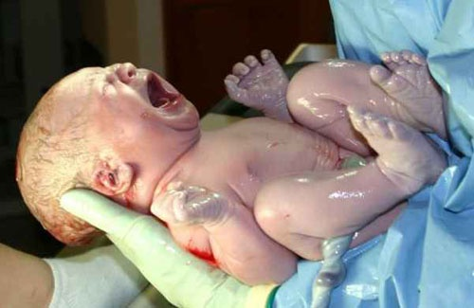
Newborns
Usually around 7-8 pounds and are about 18-22 inches long
APGAR test at birth and hearing test
Breastfed babies identify their mother by smell

Slide 11
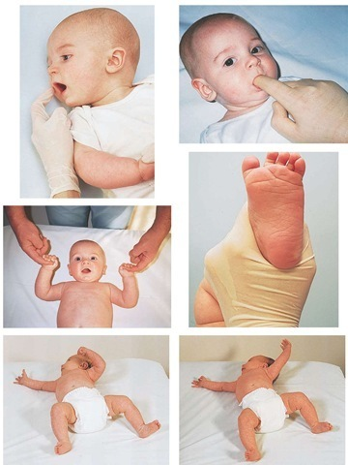
Reflexes
Rooting
Sucking
Babinski
Moro
Plantar
Swimming
Stepping
Grasping/Palmar

Slide 12
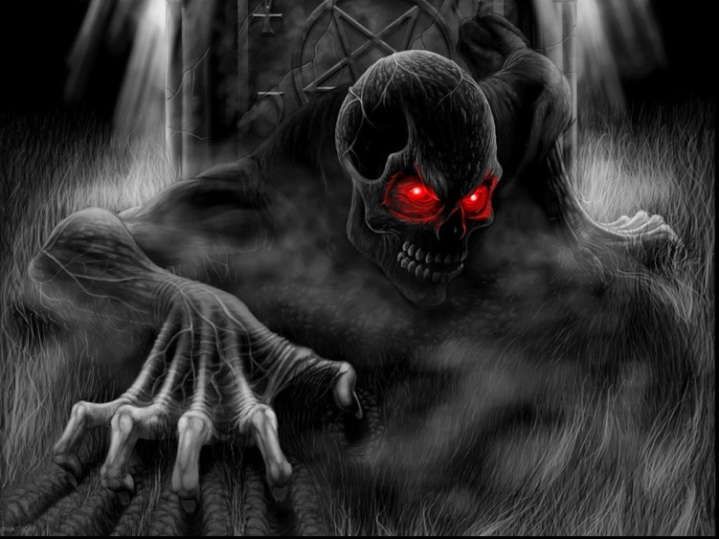
Studying Babies
Babies know a lot!
We use habituation to tell
Decrease in response after a period of stimulation
What happens when you watch a scary movie?

Slide 13
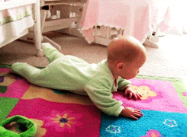
Infant Growth
Maturation-sequence of biological changes that indicate growth
Typically uninfluenced by experience
Examples
Brain development (pruning process & long-term potentiation)
Motor development (roll over rock crawl sit walk)

Slide 14
Check!
Lightly touching an infant’s cheek will result in the movement of the infant’s mouth to whichever side of his face was touched. This is known as what type of reflex?
Babinski
Moro
Palmar
Sucking
Rooting

Slide 15
Check!
Pregnant women are often told not to eat processed meats, such as hot dogs and lunchmeat, in order to avoid consuming a harmful bacteria called listeria that could cause miscarriage. Based on this, listeria could be considered a(n)
Effect of habituation
Effect of maturation
Teratogen
Zygote
Reflex

