Slide 1
Research Day 2

Slide 2
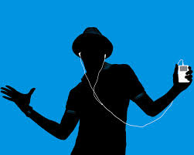
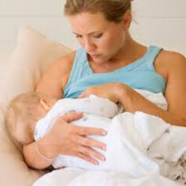
Practice!
Define “good music” in terms of its operational definition.
Dr. Bowman conducts an experiment to determine if breastfeeding babies can cause increased IQ test scores, when children are tested at age 8.
  Identify the following:
    independent variable
    dependent variable
    confounding variables
    experimental group
    control group

Slide 3
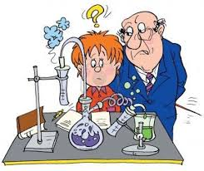
Recap
Experiment-research method in which one factor is manipulated and its effects are recorded
  Can determine if one element CAUSES an effect

Slide 4
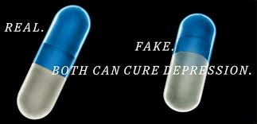
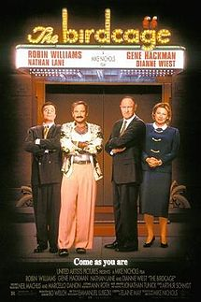
Bias in Experiments
Placebo-”sugar pill”
  Placebo effect
Single-blind
  Participants DO NOT know if they are in experimental or control group
Double-blind
  Experimenter and participants do not know if they are in experimental or control group

Slide 5
Research Methods
Research Methods
Description Methods
Correlation Method
Causation Method
Experiment
Survey
Case Study
Naturalistic Observation

Slide 6
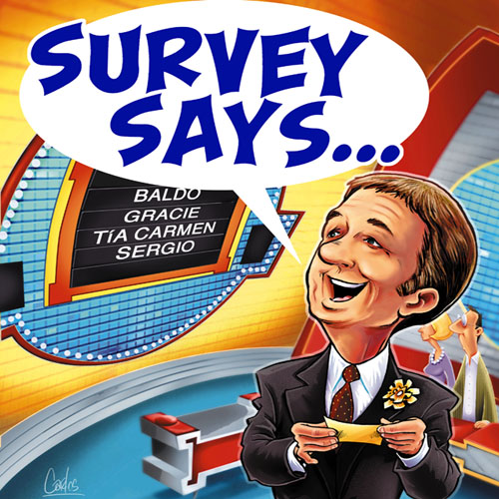
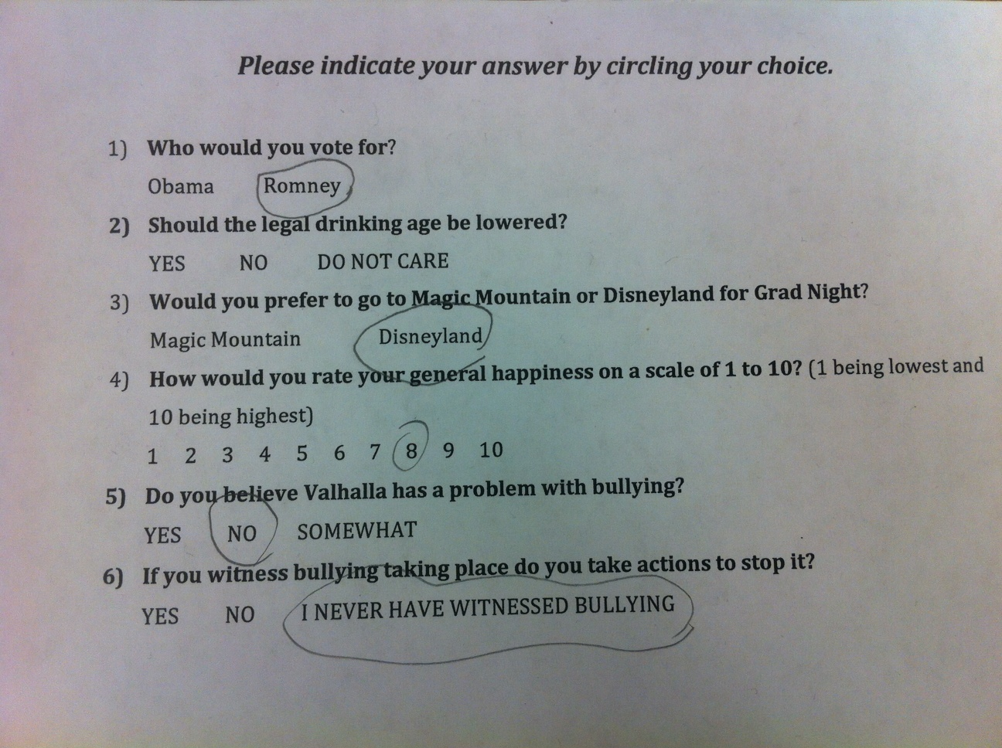
Survey

Slide 7
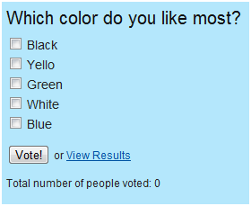
Survey Examples
Gallop political polls
  What percentage of Americans support President Obama?
Dancing with the Stars polls

Slide 8
Wording Effect
One currently hot idea to unclog America's courtrooms is to make losers in civil suits pay the legal expenses of the winners. In a recent Washington Post-ABC News, 1,524 adults were asked the following questions:

Slide 9
Support, Oppose, No Opinion
Group 1
"Would you support or oppose a law that says if you sue someone and lose, you have to pay their legal expenses?”
Support = 47%
Oppose = 50%
No Opinion = 3%
Group 2
"Would you support or oppose a law that says if someone sues you and loses, they have to pay your legal expenses?"
Support = 80%
Oppose = 18%
No Opinion = 2%

Slide 10
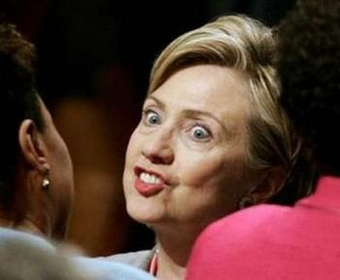
A Time magazine poll in 1993 used two the then-First Lady's name in two different ways in its polling with these results:
56.8% gave Hillary Clinton a favorable rating, while 25.6% said unfavorable.
49.4% gave Hillary
Rodham Clinton favorable, with 30.6% unfavorable.

Slide 11
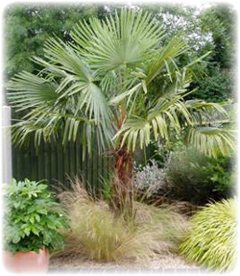
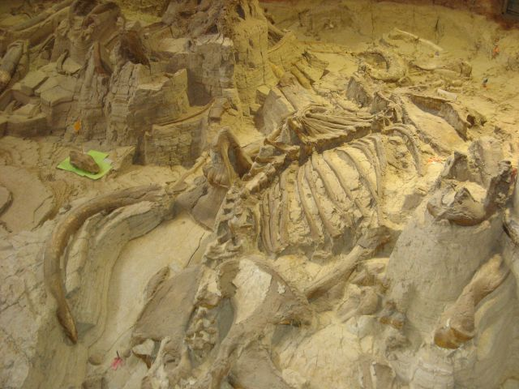
1255 people were surveyed by New York’s American Museum of Natural History:
77% interested in plants and trees, but only 39% interested in botany
48% interested in fossils, but only
39% interested in paleontology
42% interested in rocks and minerals, but 53% interested in geology

Slide 12
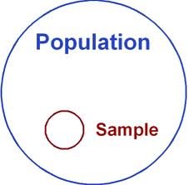
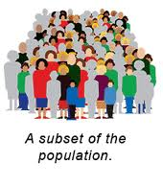
Random Sampling in Surveys
Participants MUST BE RANDOMLY CHOSEN
  Chosen out of a hat
  Computer generated

Slide 13
Bell Work
Ms. Duong and Ms. Germany want to conduct a study to determine which school policies the students support or oppose. They plan to survey the first 50 students who enter school on Monday morning. Do you think their results will be accurate? Why or why not?
What are the strengths and weaknesses of this survey?

Slide 14
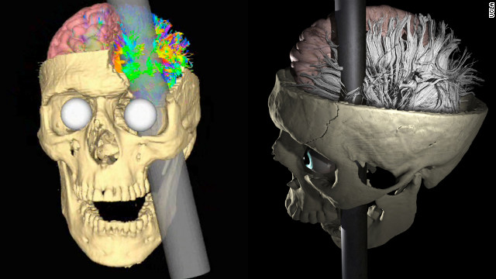
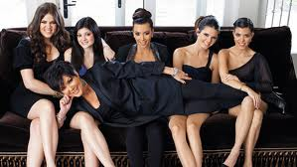
Case Study
Examine one individual in depth in hopes of revealing things true of all
Genie the Wild Child 4:48
Phineas Gage
The Kardashians

Slide 15
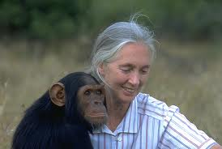
Naturalistic Observation
Observing and recording behavior in naturally occurring situations without interfering
Jane Goodall and the chimpanzees

Slide 16
Get ready for the lunchtime naturalistic observation!

Slide 17
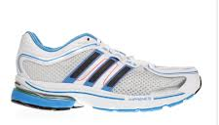
Correlation
Say it with me: CORRELATION DOES NOT IMPLY CAUSATION!
Study to find a relationship between two variables to see if they associate or correlate
DOES NOT PROVE CAUSATION (only an experiment can do that)
Example: Does size of brain contribute to intelligence?

Slide 18
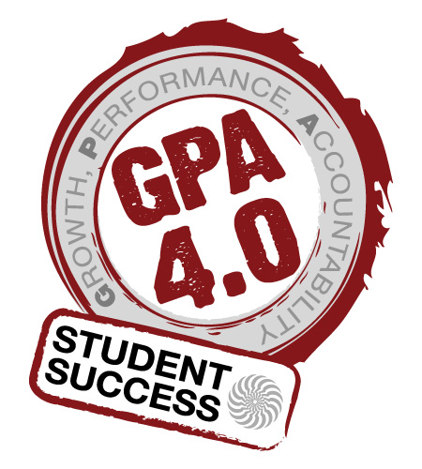
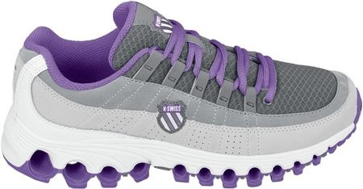
Let’s do a Correlational Study!
Ask your neighbors what their shoe size is, and record it under Factor 1.
Then ask your neighbors what their GPA is, and record it under Factor 2.

Slide 19
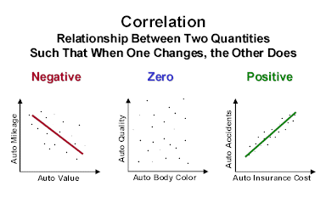
Correlation
Correlations range from -1 to +1 (correlation coefficient).
  The number is the STRENGTH of the correlation!
  Positive (+) correlations mean that as one variable increases, so does the other
  Negative (-) correlations mean that as one variable increases, the other decreases
Track data on a scatterplot

Slide 20
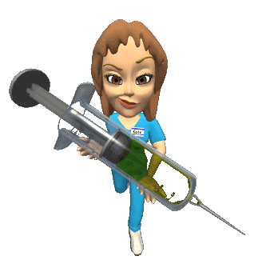
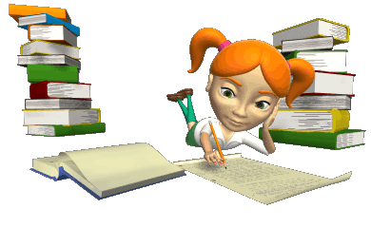
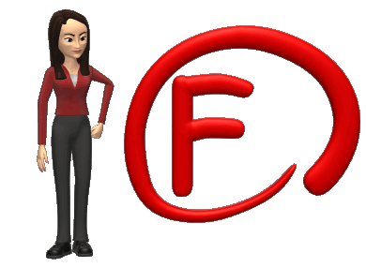
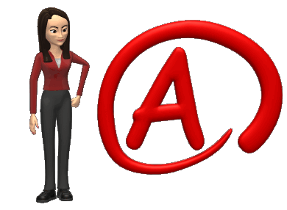
Positive Correlation
The variables go in the SAME direction.
Negative Correlation
The variables go in opposite directions.
Studying and grades hopefully has a positive correlation.
Heroin use and grades probably has a negative correlation.

Slide 21
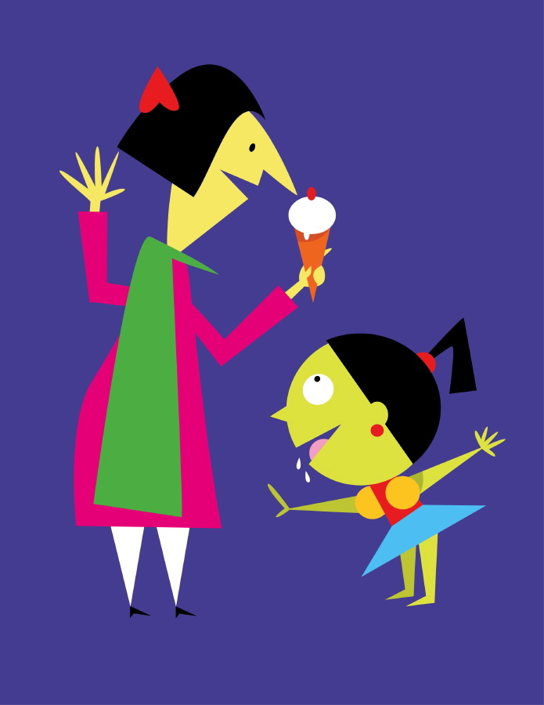
Correlation Examples-Positive or Negative?
  Temperature and
  ice cream eaten
      Positive
  TV watched and
  grade performance
    Negative

Slide 22
Which is a stronger correlation?
-.13 or +.38
-.72 or +.59
-.91 or +.04
-1.1 or +.42
-.01 or +.4
Hint: Stronger means higher numeral (correlational coefficient)!

Slide 23
Illusory Correlations
Perception of a relationship where none exists
Thinking that a correlation exists when it really doesn’t
Can you think of examples??

