Slide 1
Research Day 3

Slide 2
Bell Work
Identify the type of study described for each of the following scenarios:
1. Campbell’s Soup issues a questionnaire to 1,000 American moms over which type of soup their family prefers.
2. A group of psychologists interview, observe, and analyze the life of John G. Raymond, a lawyer whose arms and legs were amputated after a car accident, to understand the physical and emotional effects of physical trauma.
3. Pfizer conducts a study to test a drug in treating schizophrenia. Half of participants receive this drug, and half of the participants receive a placebo. Pfizer collects data from each group of patients and makes a conclusion about the data.
4. Dr. Livingstone travels to the Philippines to collect data about the role of family in indigenous cultures. He observes these cultures but does not interview them.
5. For their marketing strategy, Oscar Meyer collects data to see if there is a relationship between one’s age and the amount of hot dogs one eats.

Slide 4
Histogram-depicts frequency distribution

Slide 5
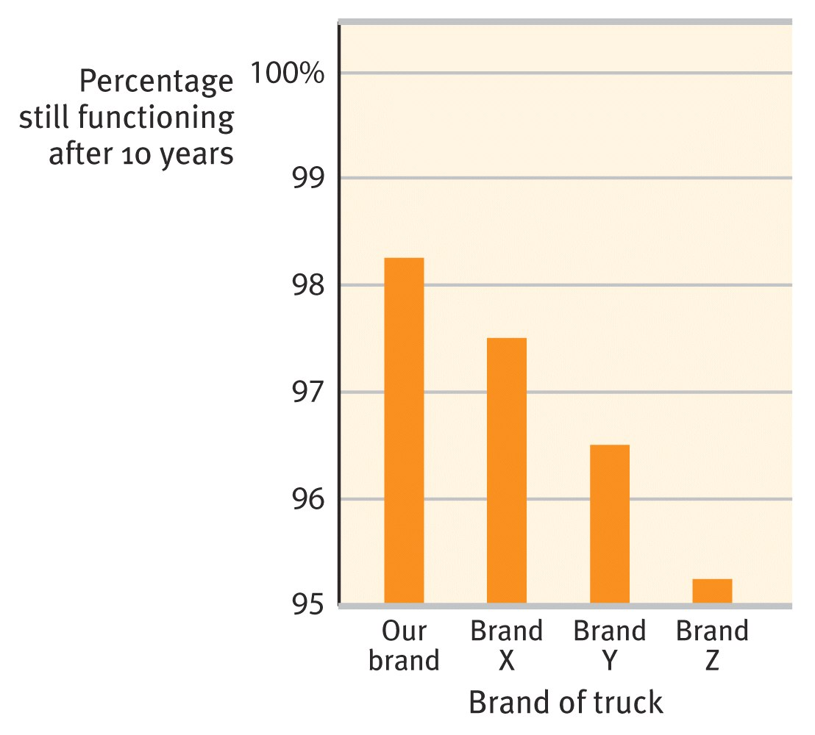
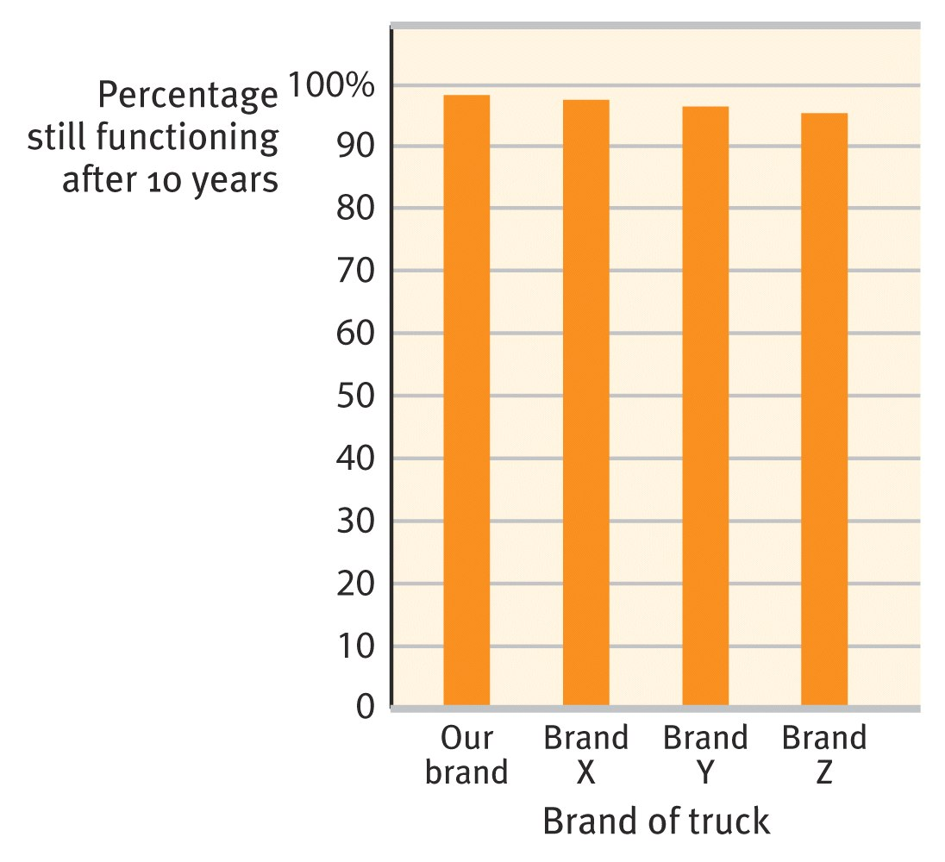
Check out this data!

Slide 6
Data can be misleading…especially when you see it on TV

Slide 7
This is why we have statistics (the study of the collection, organization, analysis, interpretation, and presentation of data)

Slide 8
Types of Data
Type of statistics used for a set of data depends on what type of data is collected
Nominal Data-data that identifies categories
Ex: Gender, Class level (junior, senior, etc.), Yes/no answer on surveys
Ordinal Data-identifies the order in which data fall in a set
Ex: Ranking items, such as class rank, Top 20 songs
Interval Data-data that fall within a number line that has a zero point
Ex: Height, weight (height/weight of zero means no weight or height)
Ratio Data-data that fall within a number line where zero is just another number on the line
Ex: Temperature (temperature of zero does not mean there is no temperature…it can get colder!)

Slide 9
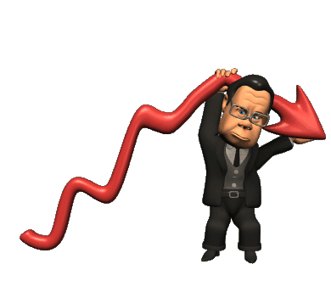
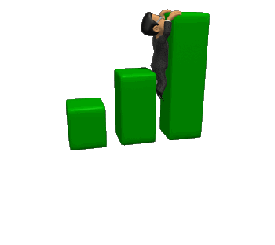
Descriptive Statistics
Describes a set of data, usually on a histogram or other chart
Measures of Central Tendency
Mean-average of data
Median-middle score in a rank distribution
Mode-most frequently occurring score

Slide 10
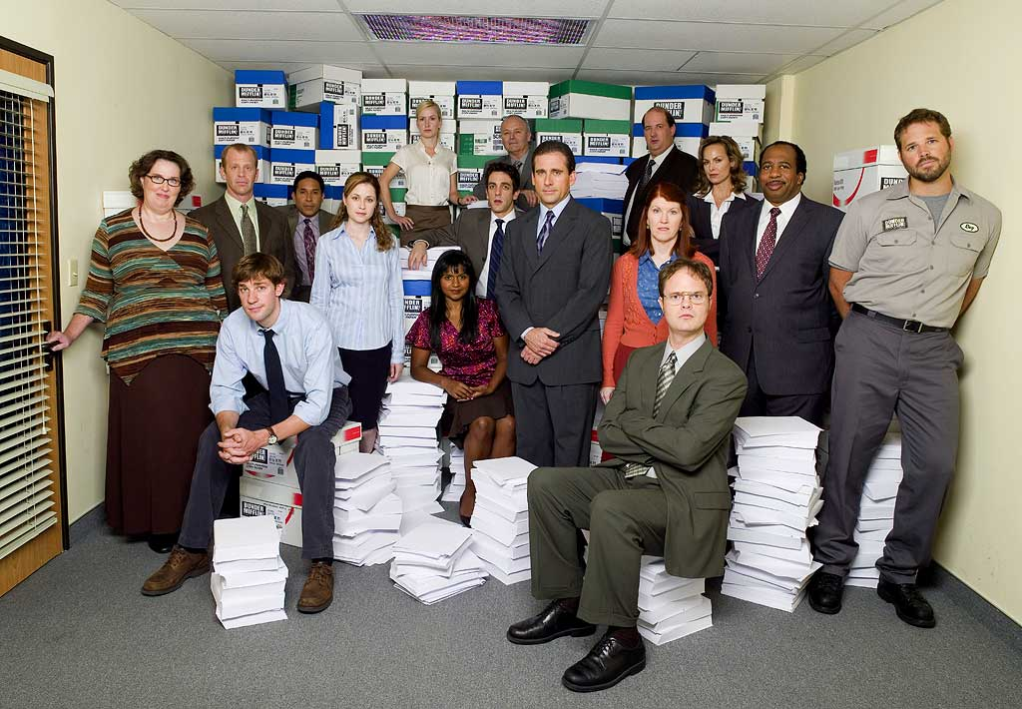
Central Tendency
Watch out for extreme scores or outliers.
Let’s look at the salaries of the employees at Dunder Mifflin Paper in Scranton:
$25,000 - Pam
$25,000 - Kevin
$25,000 - Angela
$100,000 - Andy
$100,000 - Dwight
$200,000 - Jim
$300,000 - Michael
The median salary looks good at $100,000.
The mean salary also looks good at about $110,000.
But the mode salary is only $25,000.
Maybe not the best place to work.
Then again living in Scranton is kind of cheap.

Slide 11
Practice!
21 students ages 13-17 were asked how many hours a day they spend on Facebook.
1, 3, 5, 2, 7, 4, 5, 5, 1, 3, 2, 9, 12, 4, 3, 2, 2, 1, 8, 2, 3
Calculate:
Mean
4 hours
Median
3 hours
Mode
2 hours
Range
12 hours-1 hour =11 hours

Slide 12
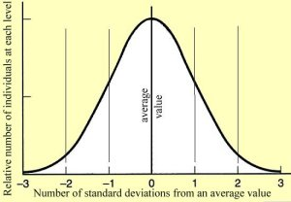
Bell Curve
Ideally, the mean, median, and mode are all the same.
This data can be shown on a normal or “bell” curve.
Test scores:
76, 78, 80, 80, 80, 82, 84
Mean=80
Mode=80
Median=80

Slide 13
Skewed Data
What if our mode, mean, and median aren’t all the same? Then we have a Skewed Distribution

Slide 14
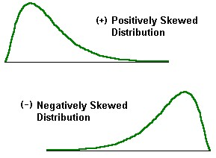
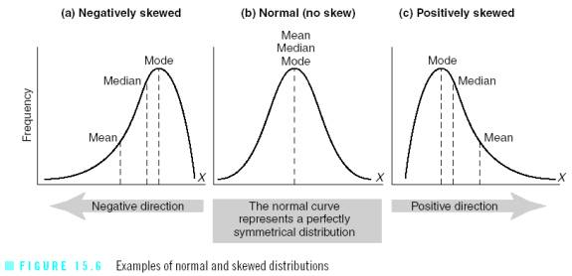
Distributions
Outliers skew distributions.
If group has one high score, the curve has a positive skew (contains more low scores)
If a group has a low outlier, the curve has a negative skew (contains more high scores)

Slide 15
Positive or Negative Skew?

Slide 16
Test Scores for the US History Quiz
1st period scores
78, 80, 80, 80, 78, 76, 80, 82, 84, 86, 80, 74, 82
Mean score is 80
2nd period scores
60, 60, 70, 70, 90, 90, 100, 100
Mean score is 80
How do these two classes compare in terms of the test score data?
Even though the mean is the same, there was more variety in test scores for 2nd period.
This “variety” is measured by standard deviation

Slide 17
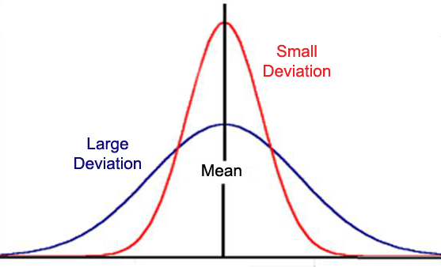
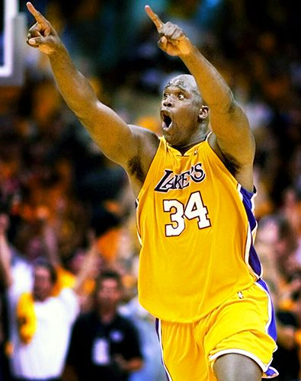
Standard Deviation
A computed measure of how much scores vary around the mean.
The higher the variance or SD, the more spread out the distribution is.
Do scientists want a big or small SD?
Shaq and Kobe may both score 30 ppg (same mean).
But their SDs are very different.

Slide 18
Standard Deviation
High SDs shows greater variability in data.
In other words, scores were “all over the place”
Low SDs shows less variability in data.
In other words, scores were similar.
Calculation for SD can be found on page 39 in the textbook (1st Ed) or page 59 (2nd Ed).

Slide 19
Wechsler Adult Intelligence Scale
SD is 15
Average score is 100
68% of population will score within 1 SD (within 15 points above or below 100
95% of population will score within 2 SDs (within 30 points above or below 100)

Slide 20
Inferential Statistics
Numerical data that allows researchers to generalize (apply to data to a larger population)
Making conclusions about data!

Slide 21
Statistical Significance
way of determining that the results are not likely to have occurred by chance (are not random)
Is measured as a decimal or percentage (.05 or 5%)
5% statistical significance means that there is 5% chance that results are caused by chance=good

