Slide 1
Research Methods Review

Slide 2
Scientific Method
Theory
Explanation using an integrated set of principles that organizes observations and predicts behaviors or events
Hypothesis
Testable prediction
Operational definitions
Statement of procedures used to define research variables
Replicate
Repeating a study to see if same results are achieved

Slide 3
Types of Research Methods
Experiment
Correlational study
Case Study
Naturalistic Observation
Survey

Slide 4
Experiment
Characterized by an independent variable and dependent variable
IV: factor that is manipulated
DV: result of the manipulation
Controls
Confounding: extra variables that could influence the outcome
Find causal relationship
IV/DV Practice http://faculty.frostburg.edu/mbradley/ivdv.html

Slide 5
Experiment-Example
Dr. Jones is testing a new medication to see if participants suffering from depression have improved mood.
IV is medication
DV is mood
Confounding variables?
Operationally define “improved mood”

Slide 6
Experiment
Population: all possible subjects to be tested
Members of population will then be RANDOMLY selected to participate in the study—random sample
THEN, participants in the random sample will be RANDOMLY ASSIGNED into either the experimental group or the control group

Slide 7
Experiment-Example
Population
People with depression
Random sample
Selecting participants from the population by chance
Random assignment
Selected participants will be divided into an experimental group (takes meds) and control group (takes placebo)
Double blind procedure: doctor and participants do not whether they are receiving med or placebo

Slide 8
Correlation
Measure of the extent to which two factors vary together
DOES NOT MEAN THAT ONE THING CAUSES ANOTHER, ONLY THAT THERE IS A RELATIONSHIP BETWEEN THE TWO
Ex: hot dog sales increase during the summer, but does NOT mean that summer causes hot dog sales
Correlational coefficient is the statistical measure of this relationship
-1.0 to 1.0

Slide 9
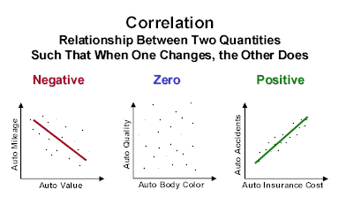

Slide 10
Correlation Practice-Positive or Negative
Correlation game http://istics.net/stat/Correlations/
The relationship between exercise and body weight
Negative
The more young children watch TV, the less they read
Negative
The relationship between breast-feeding and academic achievement
Positive
The more violent content teens see on TV, the more likely they are to be violent.
Positive

Slide 11
Case Study
Observation technique in which one person is studied in depth
NOT OFTEN “GENERALIZABLE” TO THE PUBLIC

Slide 12
Naturalistic Observation
Observing and recording behavior in naturally occurring situations without trying to manipulate and control situations

Slide 13
Survey
Quick and inexpensive questionnaire
Wording effect can cause problems
Effective as long as sample is RANDOM

Slide 14
Research Methods Practice
Dr. Timmons watches the Maori tribesmen in their village to study their mating habits.
Naturalistic observation
Dr. Anthony studies and interviews Amanda Bynes to learn about the effect of childhood stardom.
Case study
Dr. Johnson is studying the relationship between alcohol use and barbeque-related house fires.
Correlation
Dr. Ikman sent questionnaires to couples to learn if love increases with age.
Survey
Dr. Nelson is testing a new OCD drug to see if it will decrease behavior rituals.
Experiment

Slide 15
Measures of Central Tendency
Mean-average score
Median-middle score
Mode-most frequently occurring score
Range-different between highest and lowest score
Standard deviation-computed measure of how much scores vary around the mean
Statistical significance-likelihood that results were the result of chance (ideal is 5%)

Slide 16
Standard Deviation

Slide 17
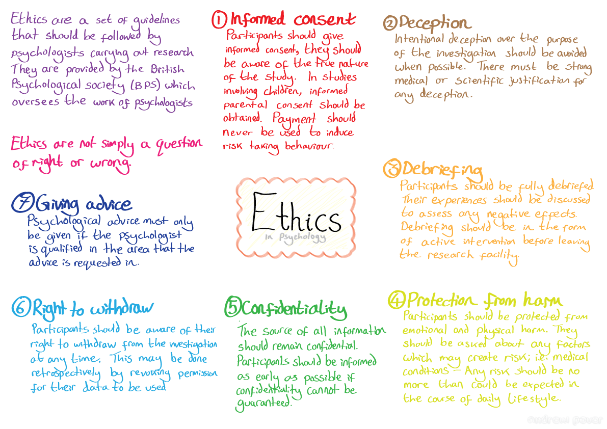
Ethics in Research
Informed consent
Debrief
No deception/harm
Animal ethics

Slide 18
FRQ
http://apcentral.collegeboard.com/apc/public/repository/ap04_frq_psych_36199.pdf

Slide 19
Extra Resources
Quizzes, PsychSims, and Flashcards http://bcs.worthpublishers.com/myersAP1e/default.asp - t_612492____
Quizlet http://quizlet.com/37632421/meyers-unit-2-research-methods-thinking-critically-with-psychological-science-flash-cards/
Online Crossword http://www.vocabtest.com/crosswords.php?tid=146424
Practice Questions-click on Research Methodshttp://www.learnerator.com/ap-psychology
Ten Toughest Terms Video http://www.youtube.com/watch?v=D39xfdlkA5w

