Slide 1
Social Development

Slide 2
Which factor influences childhood development the MOST? As always, you must use evidence to support your answer!

Slide 3
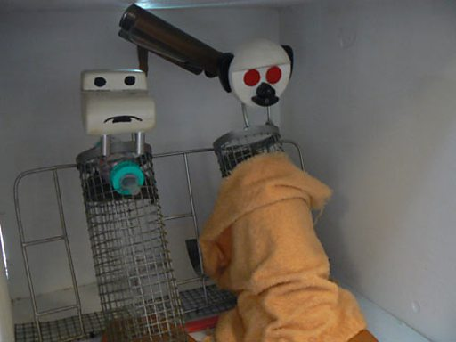
The Harlows-Attachment

Slide 4
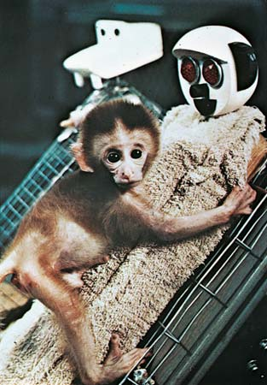
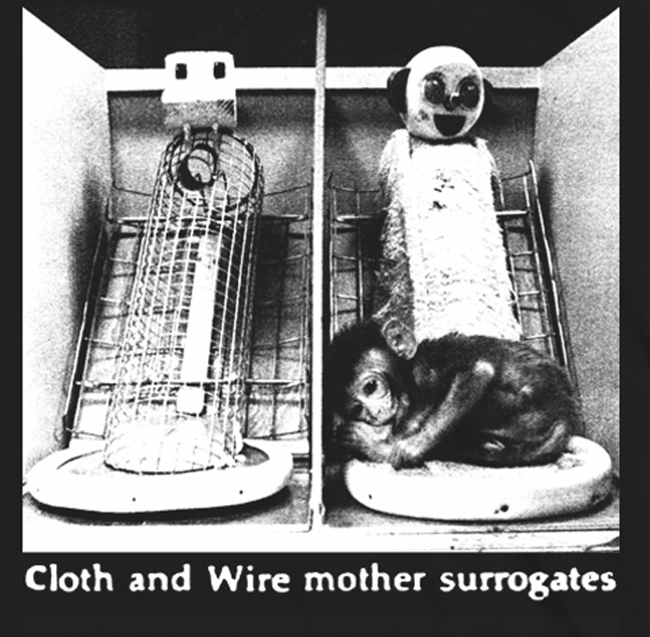
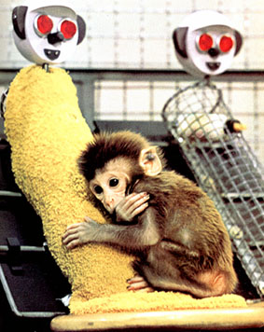
The Harlows-Attachment/Contact Comfort

Slide 5
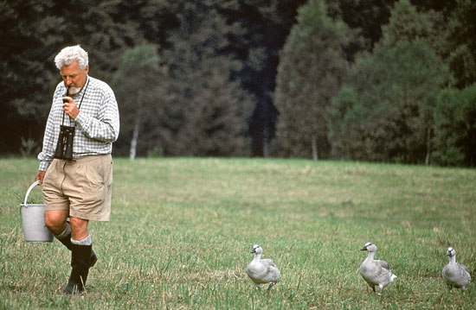
Konrad Lorenz-Imprinting

Slide 6
Mary Ainsworth-Strange Situation/Attachment Styles

Slide 7
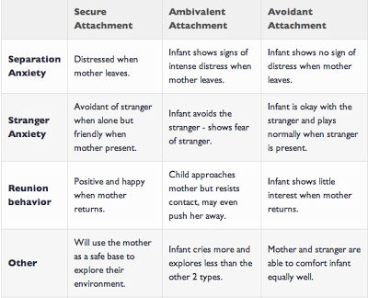
Attachment Styles
AKA anxious-ambivalent OR resistant

Slide 8
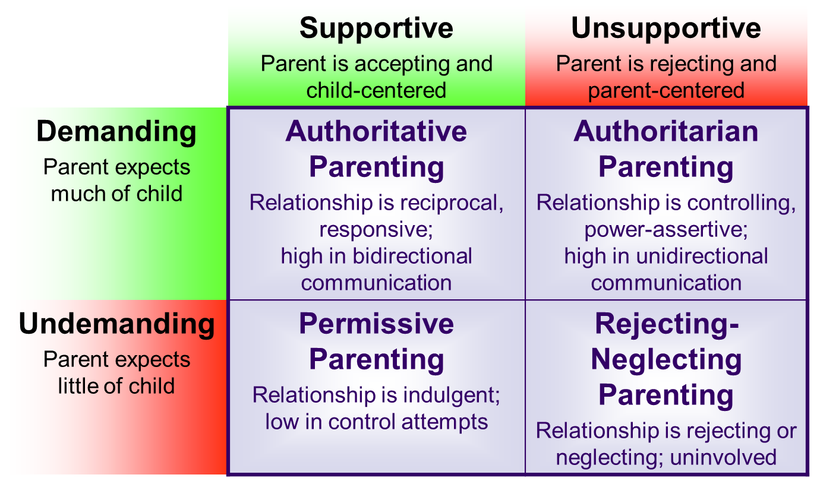
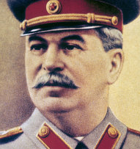
Diana Baumrind-Parenting Styles

Slide 9
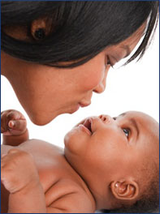
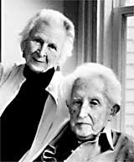
Erik Erikson-Basic Trust

Slide 10
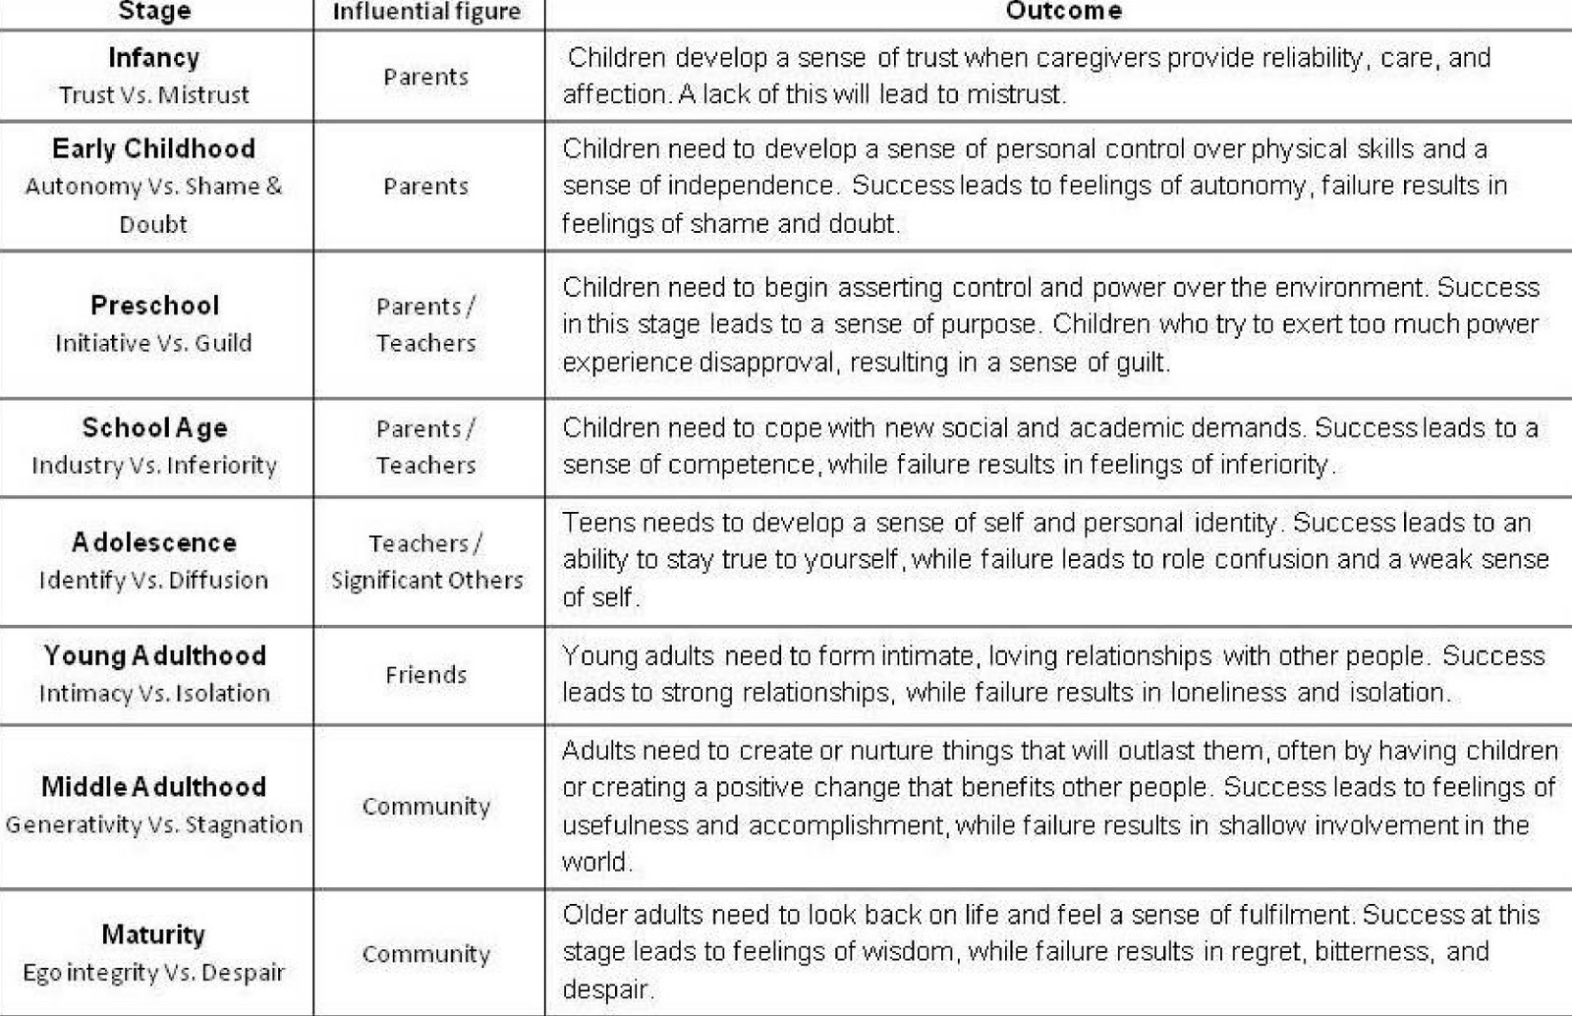
Erikson’s Stages of Development

Slide 11
Dr. Britt’s Mnemonic Device for Erikson’s Eight Stages of Social Development
https://www.youtube.com/watch?v=3BcwntGAB34

Slide 12
Checks!
The quality of infant-caregiver attachment depends:
On the quality of bonding in the first few hours of life.
Exclusively on the infant’s temperament.
On the interaction between the infant’s temperament and the caregiver’s responsiveness.
On how stranger anxiety is handled.
On whether the infant has imprinted.
Studies by Harry Harlow showed that the most important element to developing attachment is
Feeding.
Physical contact.
Kissing.
Sleep.
Mental challenges.

Slide 13
Checks!
During the second year of life, toddlers begin to take some personal responsibility for feeding, dressing, and bathing themselves in an attempt to establish what Erikson calls a sense of:
Superiority.
Industry.
Generativity.
Basic trust.
Autonomy.
According to Baumrind, the type of parenting that would most likely produce a cooperative, caring, and empathetic child is
Permissive
Avoidant
Egocentric
Authoritarian
Authoritative

