Slide 1
Bell Work
Suppose a 6th grader runs into you as you are walking to class, which causes you to drop all of your materials. The 6th grader runs away. What is your reaction? Why did he/she do this?
Suppose you meet your best friend at their locker before class. He/she slams their locker shut and storms off with no explanation. What is your reaction? Why did he/she do this?

Slide 2
Social Psychology
Social Thinking

Slide 3
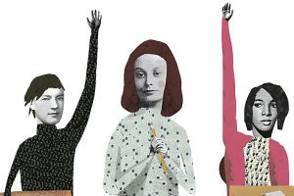
Intro Scenario
Jane is SUPER quiet in Psychology class today. Why could this happen?

Slide 4
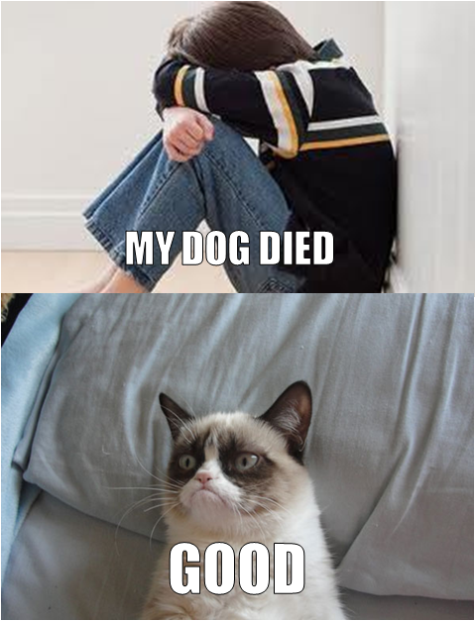
Intro scenario
We can divide the reasons why Jane is quiet in Psych class today into two categories.
Situational attributes (external)
Her dog died.
She was in a fight with her BFF.
She glued her tongue to the top of her mouth.
Dispositional attributes (internal, such as personality)
She is a quiet person.

Slide 5
Attribution Theory
Attribute=find a cause
Theory that we explain someone’s behavior by crediting either the situation or the person’s disposition

Slide 6
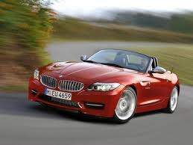
Example
A red BMW cuts you off in traffic. According to attribution theory, did he cut you off because…
He is an A-hole!
He is running late for an important meeting.
He likes to anger pretty little silver Civics.
He is on his way to the hospital because his wife is in labor.
DISPOSITIONAL ATTRIBUTE
Situational ATTRIBUTE
DISPOSITIONAL ATTRIBUTE
Situational ATTRIBUTE

Slide 7
Fundamental Attribution Error
video
Sometimes, we can make “not necessarily true” attributes about people
Often with strangers
This is called the FUNDAMENTAL ATTRIBUTION ERROR
Tendency for an observer to OVERESTIMATE the impact of personality and UNDERESTIMATE the impact of the situation
Occurs more frequently in individualistic cultures than in collectivist cultures

Slide 8
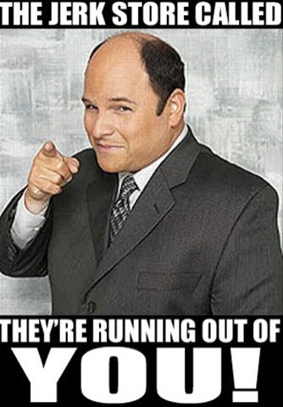
Example-Fundamental attribution error
You are walking to Psych class. Just as you enter the room, a running 6th grader slams into you, causing your books to fall to the ground and your papers to get fly all over the hallway. The 6th graders runs away without so much as a “sorry”. What is your reaction?
“What a jerk!” (attributing cause to personality/disposition)

Slide 9
Example 2-Fundamental attribution error
You are randomly assigned into a group of students from the entire school and given the task of picking up all of the trash in the building. Out of the five group members, one 9th grader refuses to pick up trash and spends his day picking the dirt off his shoes in between naps. What is your reaction?
“What a lazy bum!” (attribute to personality/disposition)
What if he his mother was arrested the night before, and he is trying to process this change in his life? (we tend not to consider any situational variables in a stranger’s life)

Slide 10
Connections to today?
Muslims after 9/11
“He must be a crazy, religious nut!”
Others?

Slide 11
Example 3
You meet your BFF at their locker after 1st period to attend Psych class. Your BFF looks angry and slams his/her locker shut, cutting you off from asking, “Did you do your Psych homework last night?” What is your reaction?
For most BFFs, it’s “He/she is probably having a bad day.” (situational attribution, NOT dispositional attribution)
This is because you know your BFF well and are more likely to see your BFF’s perspective than a stranger.

Slide 12
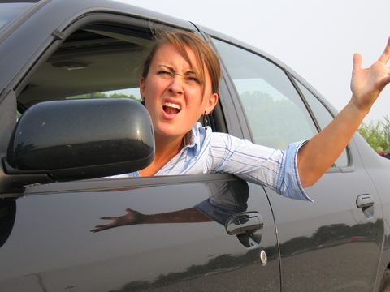
Example 4
You are in nightmare, rush-hour traffic. You cut off a little old lady in a Buick in order to get to your destination more quickly. How do you justify this action?
“Sorry, dude. I need to pick up my kids at 5.”
“Whatever, Granny. I’m late for work.”
All situational attributions
WHY?

Slide 13
Actor observer bias
In situations where oneself or one’s friend is the “actor,” the tendency to OVERESTIMATE the situation and UNDERESTIMATE disposition, or personality
The previous two situations
If I refuse to do my homework, it is not because I’m lazy! It’s because I had to help my mom do the dishes! Wink, wink!

Slide 14
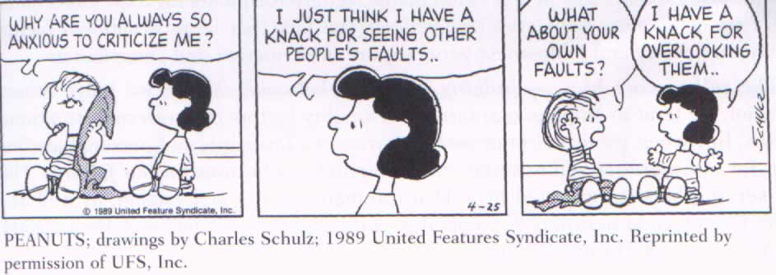
Self-serving bias
video
Tendency to take more credit for good outcomes and less credit for bad outcomes
Example: AP Exam
If my students all pass the exam, it’s because I am an awesome teacher who prepared my kids super well!
If my students all fail the exam, it’s because they didn’t study and are bad students.
Can you think of any situations where you have used the self-serving bias?

Slide 15
Review
Which psychological concept is going on here?
1. “Man, those questions were too hard! I failed that test because the questions were unfair!”
Self-serving bias
2. “That bum has been sleeping on the park bench all day. He must not have a job, because of his laziness.”
Fundamental attribution error
3. “I fell asleep in class today, because I was up all night studying for the math test.”
Actor-observer bias

Slide 16
Bell Work
Louis was walking through a crowded hallway to his third-period class when the person in front of him stopped short. Louis immediately decided the person was inconsiderate and rude. Louis was guilty of committing
A. the self-serving bias.
B. defensive attribution.
C. the fundamental attribution error.
D. a situational attribution.
E. the actor-observer bias.
2. Who is Leon Festinger, and what was his theory?

Slide 17
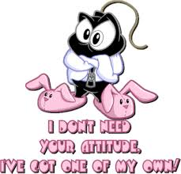
Attitudes
What does this word make you think of??

Slide 18
Attitudes
Just a set of beliefs and feelings about something, or positive or negative evaluations of objects of thought
Social issues, like gun control
Groups, like liberals, farmers, etc.
Institutions, like churches
Consumer products
People
Involve Up to Three Components:
Affect (feelings and emotions)
Behaviors (overt actions)
Cognition (our beliefs)

Slide 20
Types of attitudes
Explicit attitudes
We hold these consciously and can readily describe
Examples?
Implicit attitudes
Covert; expressed in subtle automatic responses that people have little conscious control over
Discovered while doing research on prejudice (women, the elderly, disabled)

Slide 21
How Attitude affects behavior

Slide 22
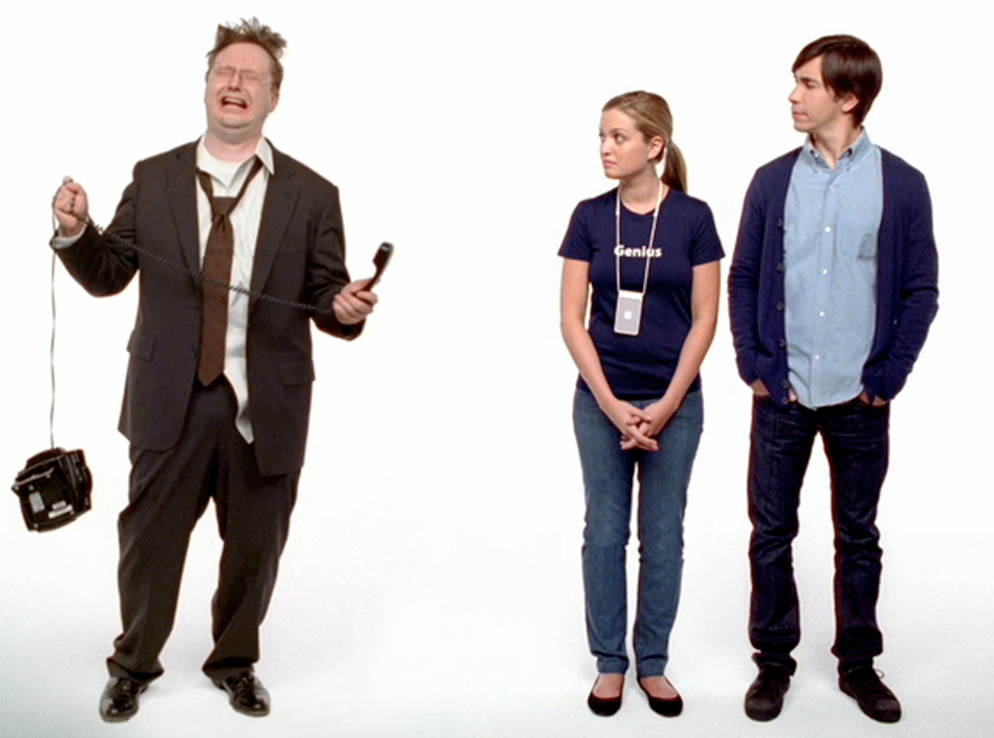
Attitudes in advertising
Advertising tried to play on our attitudes to sell their product
Message of Ad: Develop a favorable attitude towards Macs, not lame PCs, and convince viewer to purchase a Mac

Slide 23
video

Slide 24
Using Persuasion in Advertising
Central Route Persuasion: using scientific evidence and arguments that cause viewers to respond with favorable thought
Is there an example from Super-Size Me?
Peripheral Route Persuasion: using incidental cues, such as speaker’s attractiveness or celebrity endorsement
Is there an example from Super-Size Me?
video

Slide 25
Peripheral Route Persuasion

Slide 26
How behavior affects attitudes

Slide 27
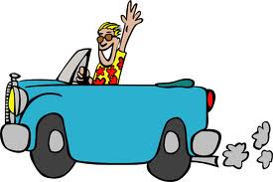
Example
Let’s say that you have just turned 16. Yes, you know what’s coming; you want Mom and Dad to buy you a car! Only problem is Mom and Dad have the attitude that you should only get a car when you turn 18.
Can you change their attitude with a behavior?
Let’s see….

Slide 28
Foot in Door Phenomenon
Tendency for people who agree to a small request to comply later with a larger one
Sooo, if you ask for a car, Mom and Dad will say no thanks to their attitude.
BUT, if you ask for something small, say a bike, then gradually work your way up to asking for a car, they are more likely to buy you a car.

Slide 29
Foor in Door

Slide 30
Foot in Door
How could you use this idea to
Negotiate a later curfew with your parents?
Convince a teacher to postpone a test?
Wear hoodies in class?

Slide 31
Door in Face Phenomenom
Tendency to comply with a small request AFTER first denying a large request
Example:
Kid: “Mom, can I have $10,000 to buy a car?”
Mom: “Are you crazy?”
Kid: “Ok, just get me an iPad instead.”

Slide 32
Door in face

Slide 33
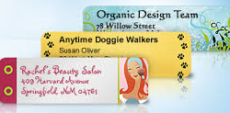
Norms of reciprocity
Tendency to return a favor after a good deed has been done for you
Example:
Charities send out personalized envelope return stickers with the hope that the recipient will send money back to the charity.
Cook Mom dinner for a month and see if she buys you a car.

Slide 34
Other ways
Lowball
Brainwashing
Write-it-down technique
Short testimonials

Slide 35
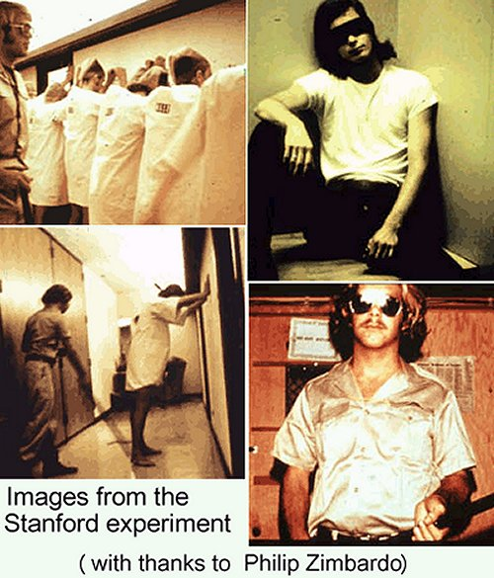
Social Roles affect attitudes
Social role-set of expectations (norms) about a social position that define how the person will behave
Zimbardo Prison Study
What were the roles?
What was the outcome of the
study?

Slide 36
Cognitive Dissonance
Occurs when our actions are NOT consistent with our beliefs
Developed by Leon Festinger
Say you are a 16-year old girl. You make straight A’s, are the president of StuCo, and are known as the all around “good girl.”

Slide 37
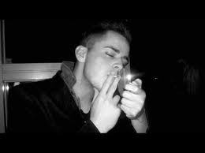
Cognitive dissonance
As the “good girl,” you naturally disapprove of underage drinking and drugs, including marijuana. You don’t hang out with people that do drugs.
BUT, you meet this guy from across the tracks…he smokes pot. He is very sweet and caring, and you tell yourself that he is such a good person. You let it slide that he smokes pot, even though you do not consider doing drugs acceptable.

Slide 38
Cognitive dissonance
Suddenly you feel a guilty tension (dissonance) within you, because you do not believe in doing drugs (your attitude), but you are hanging out with a guy who smokes pot (your behavior).
You try to rationalize your behavior by saying, “He is such a sweet guy,” and eventually you change your attitude to match your behavior. Now, you say, “Smoking pot is not such a big deal.” This helps the tension go away.

Slide 39
Cognitive Dissonance Theory
The theory that we act to reduce the discomfort (dissonance) we feel when our thoughts and behaviors are inconsistent.
When our awareness of our attitudes and of our actions clash, we can reduce the resulting dissonance by changing our attitudes.
Have you ever experienced cognitive dissonance and had to change an attitude to match your behavior?

Slide 40
Cognitive dissonance

