Slide 1
Treatment of Abnormal Psychology
A Presentation

Slide 2
Historical Treatment
Historically, persons suffering from psychological disorders have been treated with an array of harsh and gentle methods
Trephination
Blood letting
Physical violence
Electro shock therapy
…….

Slide 3
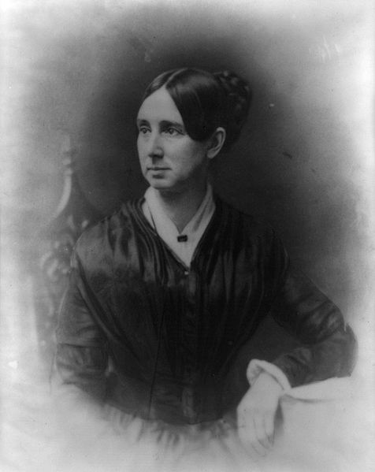
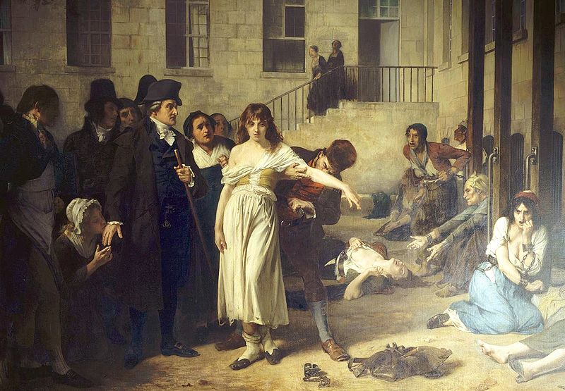
Reformers
Dorothea Dix in the 1800s
Philippe Pinel in France
Philippe Pinel

Slide 4
Psychotherapy vs. Biomedical Therapy
A trained therapist uses psychological techniques to assist someone seeking to overcome difficulties or achieve personal growth
Treatment of dissociative disorders, anxiety, mood, personality, somatoform
Treatment in which prescribed medication or medical procedure that acts directly on patient’s nervous system
Schizophrenia, depression
Eclectic approach-combination

Slide 5
Types of Psychotherapy
Psychoanalysis
Humanistic
Behavioral
Cognitive
Commonalities:
Hope for demoralized people
Establish a new perspective for patients
Create an empathetic, trusting, and caring relationship between therapist and patient

Slide 6
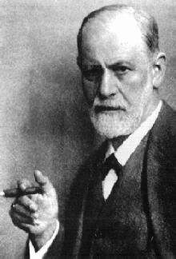
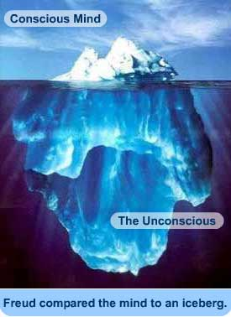
Psychoanalysis
Psychological problems (usually anxiety) are caused by repressed impulses and childhood conflicts that are stored in the unconscious mind
To solve these problems, bring the repressed conflict into the conscious awareness

Slide 7
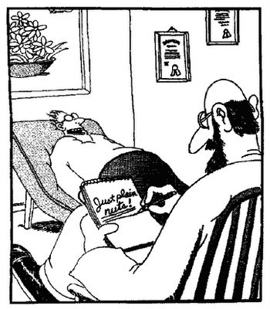
Psychoanalysis Methods
Free Association
Patient lays down on a couch and relaxes
Without looking at the therapist, patient talks about whatever they want to.
Therapist writes down what patient says, noting resistance (blocks of free association), and interprets its meaning
Ex. “My mother once told me to err….never mind; it’s not important.”

Slide 8
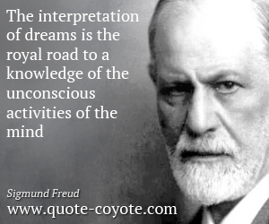
Psychoanalysis Methods
2. Dream Interpretation
-Dreams give clues to the meaning of repressed thoughts
-Manifest content vs. latent content
-Freud believed that he could distinguish latent content to further delve into the unconscious

Slide 9
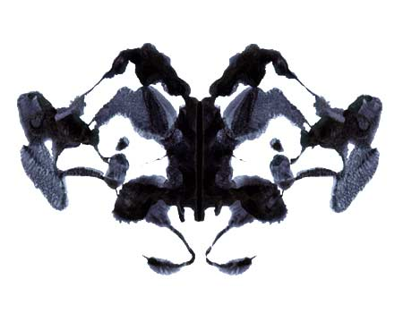
Rorschach Inkblot Test
Test used by Freudian psychoanalysts to determine latent content
“If for example my manifest content from the four pictures is (starting from left to right) two seeing horses rubbing butts, a four armed boxer alien with two penises, two seahorses comparing penises, and an alien looking at a penis; the therapist would look at the theme of my manifest content (figure it out for yourself) and put together the latent content and hoping that it reflects issues in my unconscious.”

Slide 10
Dream Scenario
“Before I went to bed, I was anxious about an upcoming test. My palms were sweaty, and my stomach kept turning in a knot. When I fell asleep, I dreamt that I was in the Sahara Desert. Sand was all around me, and suddenly, there was a brown spotted snake that was the length of a car. The snake slithered towards me, but my legs were frozen. The snake kept getting closer to me and in an instant, threw his head back then forward, sinking his fangs into my leg as he did so. The pain was excruciating, like a burning and freezing at the same time”
What is the manifest content?
What is the latent content?

Slide 11
Psychoanalysis Methods
3. Hypnosis
-state of heightened suggestibility
-Freud believed that under hypnosis, one could access their unconscious easier
-we will learn more about this in December

Slide 12
Psychodynamic Therapy Today
Engage in “talk therapy” face to face about once a week
Therapist will interpret common, recurring themes, from childhood and adult life and give insight into the person’s depression or anxiety
https://www.youtube.com/watch?v=QV6DpJKW6a0
Example of insight
http://www.youtube.com/watch?v=l_UtFKgeHsY

Slide 14
Humanistic Approach
Aim to boost self-fulfillment by helping people grow in self-awareness and self-acceptance by proving clients with new insights
Different from psychoanalysis in that humanists
Focus on the present and future
Focus on conscious thoughts
Take responsibility for actions
Promote growth instead of curing illness

Slide 15
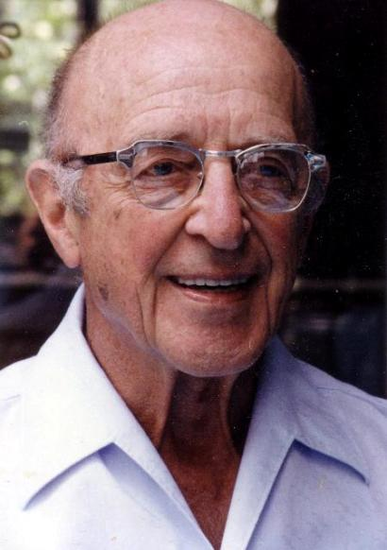
Carl Rogers-Humanistic
Client-centered therapy-focus on conscious self-perceptions
Therapist listens without judging or interpreting
Therapist exhibits genuineness, acceptance, and empathy for client
Active listening-echoing, restating, and seeking clarification

Slide 16
Client-centered therapy
Accept and understand the client, providing unconditional positive regard
Paraphrase
Invite clarification
Reflect feelings
Example page 6
http://www.youtube.com/watch?v=RMEQkBLfHMQ

Slide 17
Check
How do psychoanalysts and humanists try to help people deal with their problems?
By giving them insight!

Slide 18
Behavior Therapies
Doubt healing power of self-awareness
View maladaptive symptoms as learned behaviors that can be modified
1. Classical conditioning techniques
2. Operant conditioning techniques

Slide 19
Classical Conditioning Techniques
Suppose a child gets scared when they see furry bunnies. Could I recondition the child to like bunnies?
Counterconditioning-A behavioral therapy that conditions new responses to stimuli that trigger unwanted behaviors.
Exposure therapy
Aversive conditioning

Slide 20
Exposure Therapy
Mary Cover Jones in the 1920s
Recondition Little Albert to like bunnies by associating bunnies with enjoyable events like eating
Let Albert eat a cookie while the bunny runs around
Exposing people to what they normally avoid was finally recognized in the 1950s with Joseph Wolpe

Slide 21
Systematic desensitization
Type of exposure therapy
A type of counterconditioning that associates a pleasant relaxed state with gradually increasing anxiety-triggering stimuli. (phobia)
Week 1-show Albert a picture of a bunny eating a lollipop
Week 2-ask Albert to draw a picture of a bunny
Week 3-Have a bunny play in a play pen in Albert’s room
Week 4-Ask Albert to touch bunny while eating a cookie
Week 5-Albert can pet bunny in his lap

Slide 22
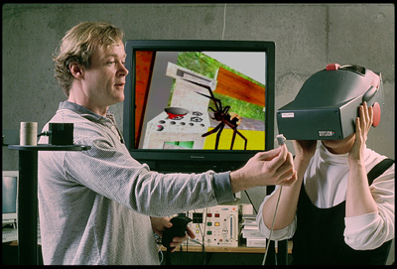
Virtual Reality Exposure Therapy
Help overcome anxiety or phobia

Slide 23
Aversive Conditioning
Counterconditioning that associates an unpleasant state with an unwanted behavior
Give a ticket citation for smoking in bars
Treat nail biting by painting nails with nasty tasting nail polish
Link drinking alcohol with nausea
Sometimes unsuccessful in the long run

Slide 24
Operant Conditioning
Behavior modification-reinforcing desired behavior and withholding reinforcement with undesired behavior
Shaping
Children with autism learn to interact
People with schizophrenia learn to behave more rationally
Token economy-patients receive a token for positive behaviors; tokens can be used to purchase treats or earn privileges

Slide 25
Cognitive Therapy
Therapy that teaches people new, more adaptive ways of thinking and acting
Based on the assumption that thoughts intervene between events and our emotional reactors
Example for depression: suggestion is criticism, disagreement is dislike, friendliness is pity

Slide 26
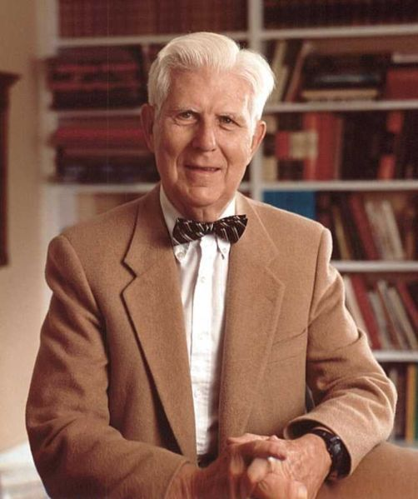
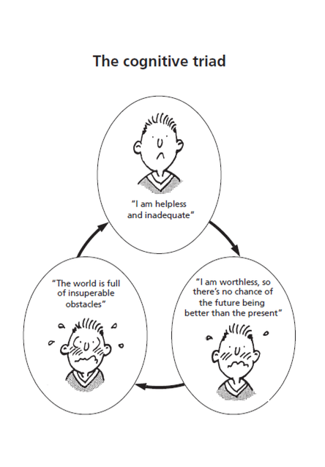
Cognitive Therapy ex.
Aaron Beck sought to reverse clients’ catastrophizing beliefs

Slide 27
Cognitive Therapy
Donald Meichenbaum wanted to change negative self-talk
Stress inoculation training: teaching people to restructure their thinking in stressful situations
Positive talk before a test

Slide 28
Cognitive-Behavior Therapy
Popular integrative therapy that combines cognitive therapy (changing self-defeating thinking) with behavior therapy (changing behavior)
Anxiety and mood disorders
Lucy from the Big Bang Theory

Slide 29
Biomedical Therapy
Cause of disorder is organic (brain, blood chemistry, neurotransmitter, etc.)
Psychiatry
Methods
Drug Therapy
Brain Stimulation
Psychosurgery
Therapeutic Lifestyle Change

Slide 30
Drug Therapy
Psychopharmacology-study of drug effects on mind and behavior
Types
Antipsychotic
Antianxiety
Antidepressant
Mood stabilizers

Slide 31
Antipsychotic Drugs
Calming drugs used to treat psychosis (break with reality), such as schizophrenia
Dampen responsiveness to irrelevant stimuli
Thorazine (chlorpromazine) blocks dopamine receptors—positive symptoms
Can produce tardive dyskinesia (involuntary movements of face, tongue, and limbs)
Clozapine target both serotonin and dopamine and help with negative symptoms

Slide 32
Antianxiety Drugs
Used to control anxiety and agitation
Depress the central nervous system
Xanax and Ativan
Physiological dependence led to criticism

Slide 33
Antidepressant Drugs
Drugs used to treat depression by lifting people up from their depression
Now used to treat anxiety, such as OCD
Increase norepinephrine and serotonin
Prozac (fluoxetine) blocks reabsorption and removal of serotonin
Selective serotonin reuptake inhibitors (SSRI) such as Zoloft and Paxil

Slide 34
Mood Stabilizing Drugs
Used to treat bipolar disorder
Lithium salt
Depakote (used to treat epilepsy)

Slide 35
Brain Stimulation
Magnetic Stimulation (repetitive trans-cranial magnetic stimulation) for depression
Deep-Brain Stimulation for depression
Electroconvulsive therapy (ECT)
Used for people with depression for whom drug therapy is not effective
Once considered barbaric, but now humane

Slide 36
Psychosurgery
Surgery that removes or destroys brain tissue
Lobotomy developed by Moniz
Not widely used because of its severity

Slide 37
Therapeutic Lifestyle Change
Aerobic exercise
Adequate sleep
Light exposure
Social connection
Anti-rumination (enhance positive thinking)
Nutritional supplements

Slide 39
Template Provided By
www.animationfactory.com
500,000 Downloadable PowerPoint Templates, Animated Clip Art, Backgrounds and Videos

