Slide 1
Bell Work
What occurs when experiences influence our interpretation of data?
A. Selective attention
B. Transduction
C. Bottum-up processing
D. Top-down processing
E. Signal detection theory
2. Tyshane went swimming with friends who did not want to get into the pool because the water felt cold. Tyshane jumped in and after a few minutes declared, “It was cold when I first got in, but now my body is used to it. Come on in!” Tyshane’s body became accustomed to the water due to
A. Perceptual set.
B. absolute threshold.
C. difference threshold.
D. selective attention.
E. sensory adaptation.
3. According to Weber’s law, in order for two stimuli to be perceived as different, the stimuli must differ
A. By a constant amount.
B. once one has been primed to notice the difference.
C. using signal detection theory.
D. by a proportion of the stimuli.
E. by a random amount.

Slide 2
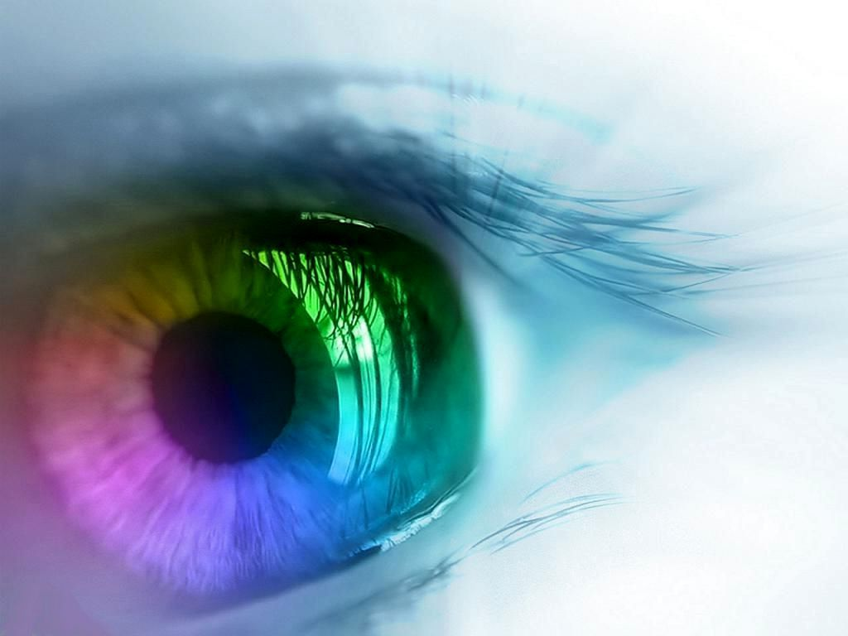
Vision

Slide 3
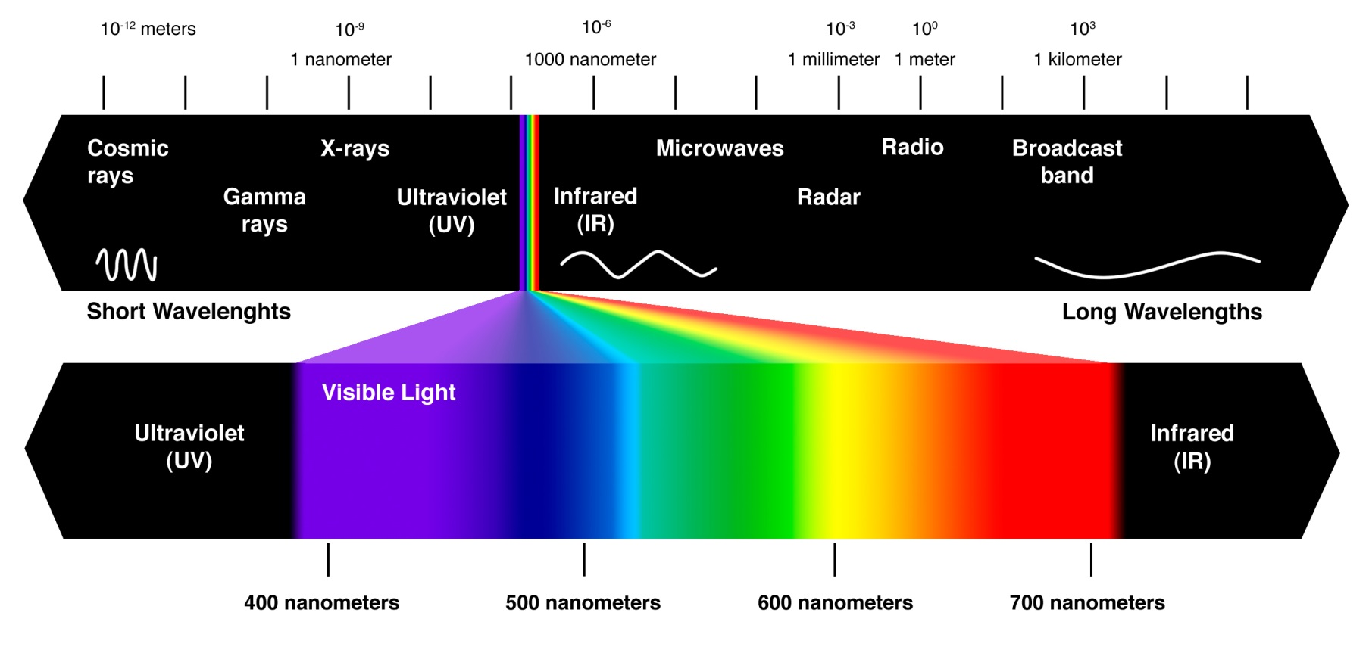
Light Energy
Our eyes receive light energy and transduce it into neural messages that our brain processes into what we consciously see

Slide 4
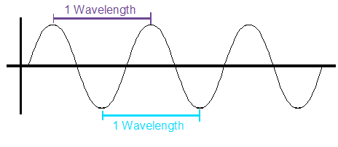
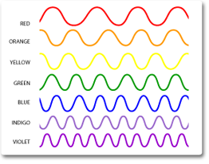
Light Waves
Wavelength determines hue, or color
Long wavelengths (red)
Short wavelengths (violet/indigo/blue)

Slide 5
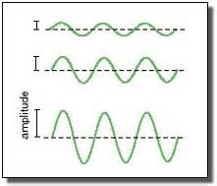
Light Waves
Amplitude determines intensity or brightness
Great/high amplitude (bright)
Small / low amplitude (dull)

Slide 6
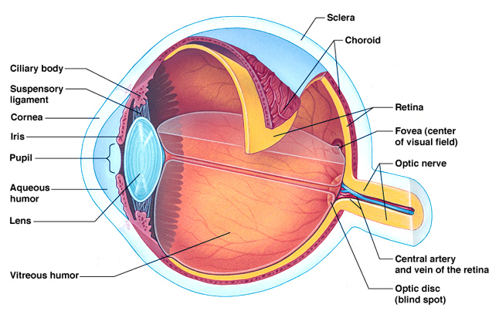
Label the parts of the eye!

Slide 7
Pen Cap Demo

Slide 8
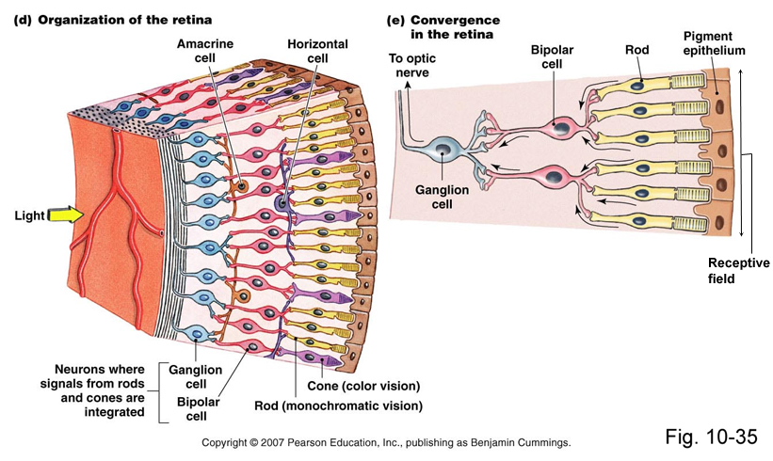
Close-up of the Retina

Slide 9
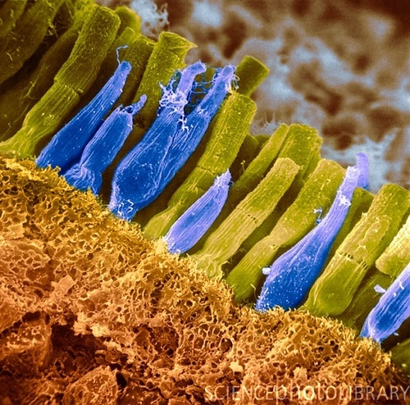
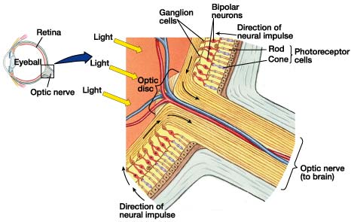
Close-up of the Retina-Optic Nerve

Slide 10
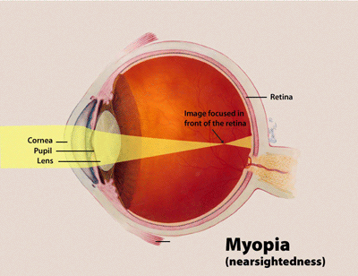
Nearsightedness (Myopia)

Slide 11
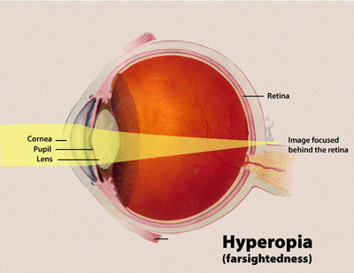
Farsightedness (Hyperopia)

Slide 12
Visual Information Processing

Slide 13
Feature Detectors
David Hubel and Torsten Wiesel
Specialized neurons in the occipital lobe’s visual cortex that receive information from individual ganglion cells in the retina and respond to specific features of the stimulus, such as shape, angle, and movement
Ex: Portion of the right temporal lobe-perceive faces

Slide 14
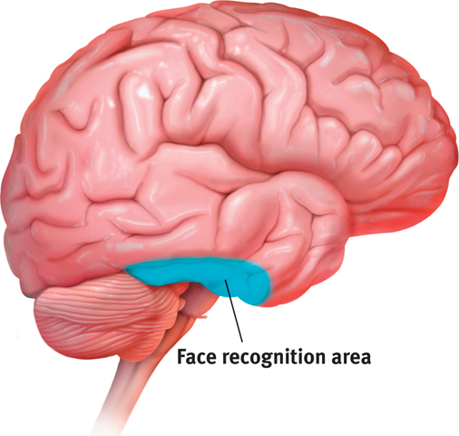
Feature Detectors

Slide 15
Destruction of Feature Detectors
Visual agnosia
Ex: Dr. P. from The Man Who Mistook his Wife for a Hat
Prosopagnosia
https://www.youtube.com/watch?v=k5bvnXYIQG8
60 Minutes Part 1
60 Minutes Part 2

Slide 16
Parallel Processing
Processing many aspects of a problem simultaneously
Opposite of serial processing (i.e. computers/conscious problem solving)
Processing motion, form, depth, and color in different areas and then integrating this information to perceive one image

Slide 17
Color Vision
Items are not colored; the color we perceive is reflected by the object and resides in our brain.
Low difference threshold for color, so we can discriminate more than 1 million color variations
1 in 50 is color deficient
Typically male, as it is genetically sex-linked on the X-chromosome
Recessive

Slide 18
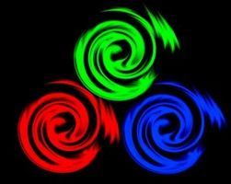
Young-Helmholtz Trichromatic Theory
Three-color theory
Retina contains three different color receptors (sensitive to red, green, and blue) and when stimulated together, can produce perceptions of any color

Slide 19
Types of Color-Deficient Vision
Monochrome Color Blindness (rare)-no cones or non-functioning cones
everything appears to be a shade of grey

Slide 20
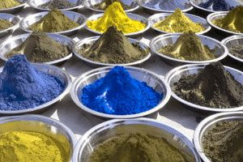
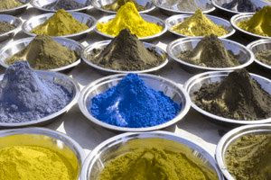
Types of Color Deficient Vision
Dichromatic Vision-one type of cone does not work properly
Most common type of red-green deficiency (lack of functioning red or green cones) in which greens and reds are confused and world is seen in primarily blues, yellows, and greys
Protanopia-unable to perceive red light (PR)
Deuteranopia-unable to perceive green light (DG)

Slide 21
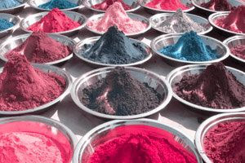
Types of Color Deficient Vision
1. Dichromatic Theory
More rare type is blue-yellow deficiency (lack of functioning blue cones) and world is seen primarily in reds, greens, and greys
Tritanopia-unable to perceive blue light (TB)

Slide 22
To Experience Color Blindness
http://neitzvision.com/content/colorblindworld.html
http://etre.com/tools/colourblindsimulator/
http://www.colourblindawareness.org/colour-blindness/types-of-colour-blindness/

Slide 23
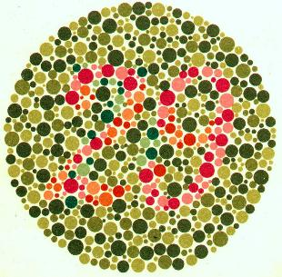
Young Helmholtz Trichromatic Theory
Who will have trouble seeing the number to the right?
These color deficiencies support the notion that there are three sets of receptors
Evidence to support trichromatic theory
What about yellow (can be seen by those who have deficient red- and green-sensitive cones)??

Slide 24
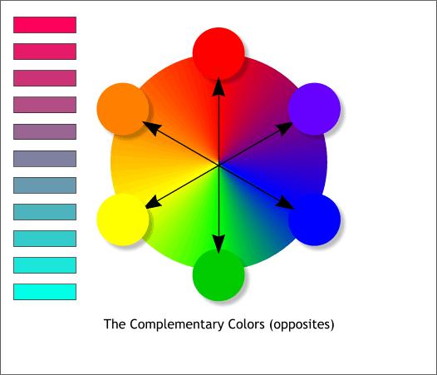
Opponent Process Theory
Ewald Hering’s theory that opposing retinal processes enable color vision
Red-green
Yellow-blue
White-black
Support for this theory can be derived from presence of afterimages (visual image that persists after stimulus is removed), the presence of yellow, and the red-green deficiency similarities

Slide 29
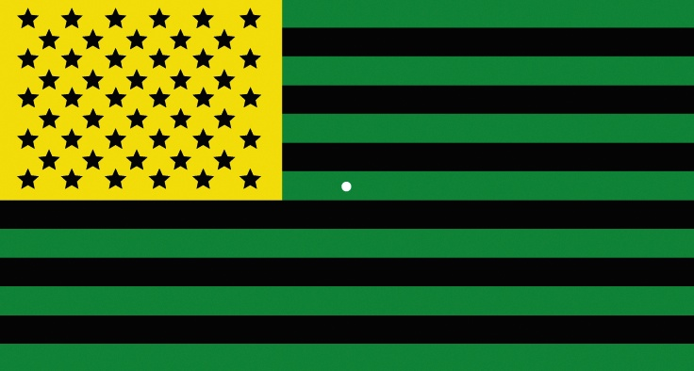

Slide 31
So….
Both theories are needed to explain color vision
Evidence: George Wald earned a Nobel Prize for demonstrating that there are three types of cones in the eye, each being more sensitive to a certain wavelength
Biological basis for opponent process: there are cells in the retina, LGN, and visual cortex that respond in opposite ways to red versus green and blue versus yellow (certain retinal ganglion cells that are excited by green and inhibited by red)

