Slide 1
Bell Work
1. The optic chiasm is
Responsible for color vision.
Where the optic nerve leaves the eye, creating a blind spot
Where the optic nerve crosses over to report information to opposite sides of the brain
Where information from rods and cones is passed to the ganglion cells
Responsible for detecting fine detail
2. What function does the retina serve?
The retina contains the visual receptor cells.
The retina focuses light coming in the eye through the lens.
The retina determines how much light is let into the eye.
The retina determines which rods and cones will be activated by incoming light.
The retina connects the two optic nerves and sends impulses to the left and right visual cortises.

Slide 2
Visual organization and perception

Slide 3
Perceptual Set
Also called expectancy
Set of mental tendencies and assumptions that greatly influence what we perceive
Linked to top-down processing
Backmasking in music
You’re going to see a young women…

Slide 4
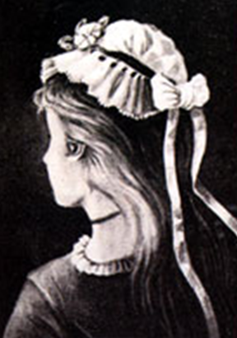

Slide 5
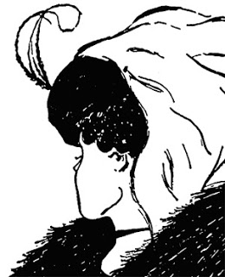

Slide 6
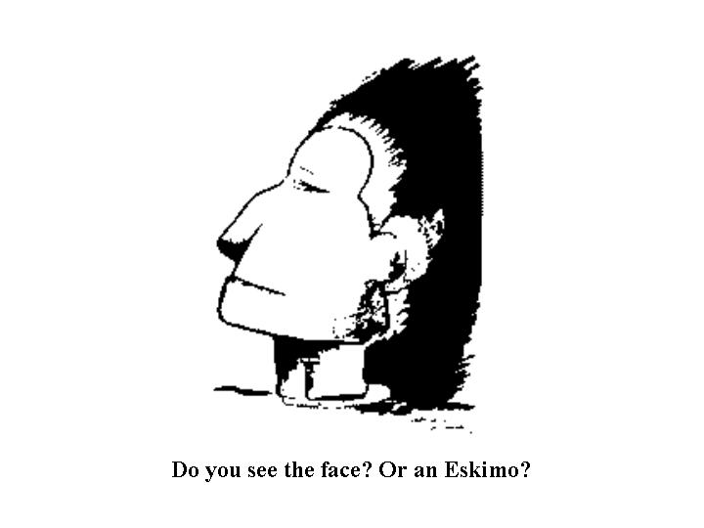

Slide 7
You’re going to see…

Slide 8
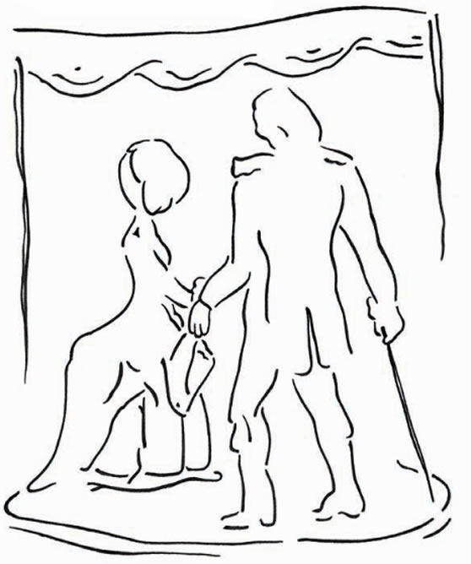

Slide 9
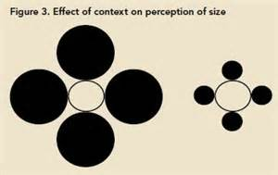
Context and Cultural Effects

Slide 13
Visual Organization
How do we organize and interpret stimuli, so that they become meaningful perceptions?
Gestalt Psychology-tendency to integrate pieces of information into meaningful wholes (gestalts)

Slide 14
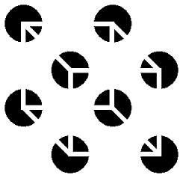
Necker Cube

Slide 15
Types of Visual Organization
Form Perception
Figure Ground
Grouping
Depth Perception
Binocular Cues
Monocular Cues
Motion Perception
Stroboscopic movement
Perceptual Constancy
Color, Shape, Size Constancies

Slide 16
Form Perception
Figure Ground-the organization of the visual field into objects that stand out from their surroundings

Slide 17
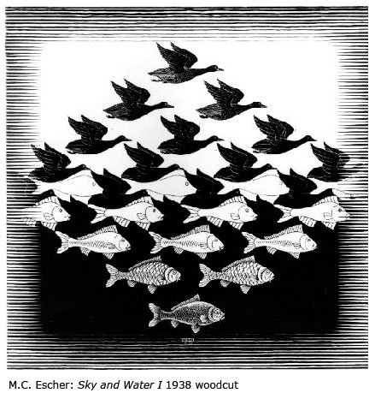

Slide 19
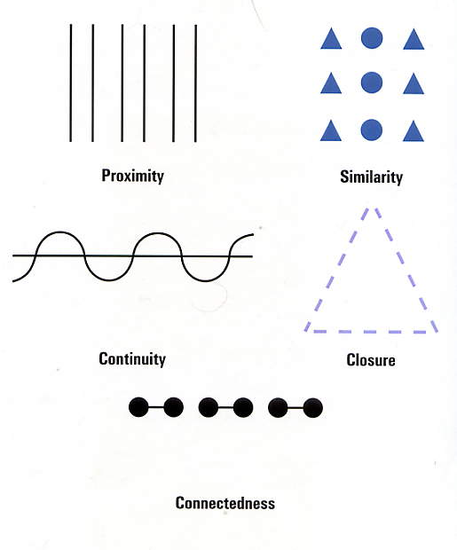
Grouping
Perceptual tendency to organize stimuli into coherent groups

Slide 20
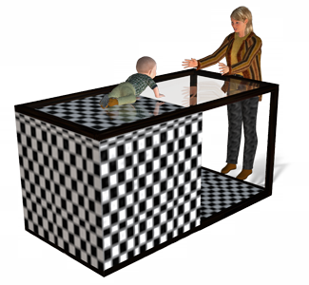
Depth Perception
Allows us to estimate an object’s distance from us
Eleanor Gibson and Richard Walk-Visual Cliff experiments
Biology predisposes us to be wary of heights
https://www.youtube.com/watch?v=1VPaBcT1KdY

Slide 21
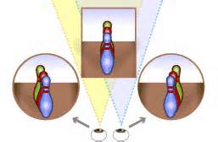
Binocular cues
Require the use of both eyes to see distance
Pencil trick
Retinal disparity-a binocular cue for depth perception; there is a distance of 2.5 inches between our eyes, so the greater the distance between the two images, the closer the object

Slide 22
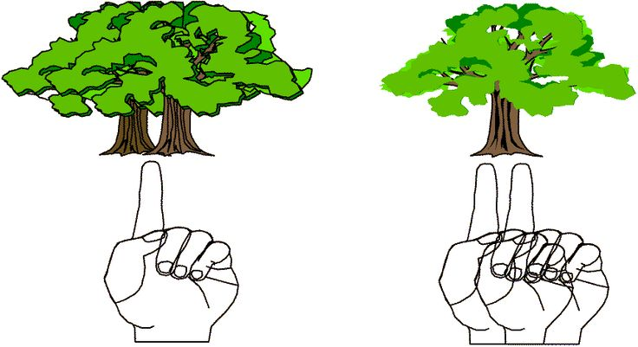

Slide 23
Monocular Cues
Depth cues that we can use with only one eye
Examples:
Linear perspective
Interposition
Light and shadow
Relative size, height, and motion
Texture Gradience
Accommodation
Motion parallax

Slide 24
Shape Constancy

Slide 25
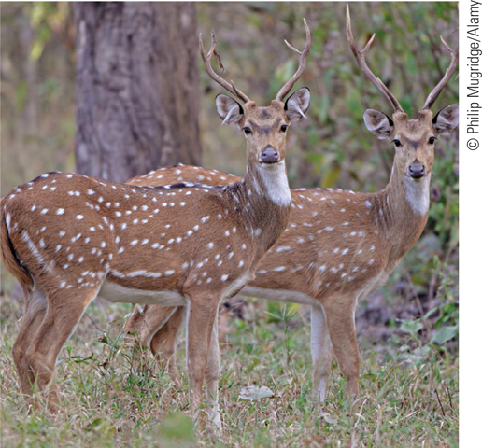

Slide 26
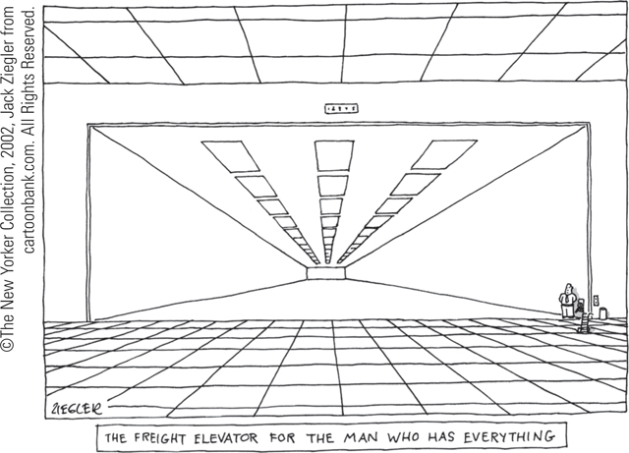

Slide 28
Motion Perception
Assumption that shrinking objects are retreating and enlarging objects are approaching
Stroboscopic movement
movies
Phi phenomenon
http://dragon.uml.edu/psych/circles_0028_red.html

Slide 29
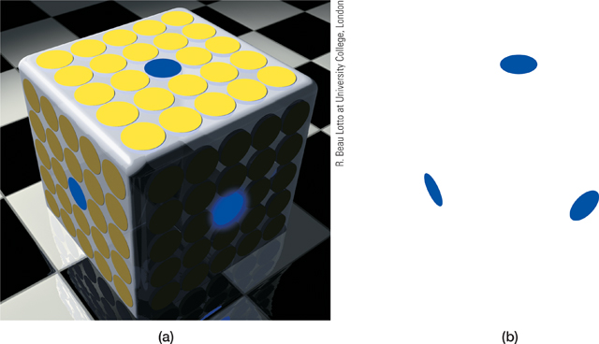
Perceptual Constancy
Perceiving objects as unchanging (having consistent shapes, size, brightness, and color) even as illumination and retinal images change
Color Constancy
http://dragon.uml.edu/psych/colors1.html

Slide 30
Shape Constancy

Slide 31
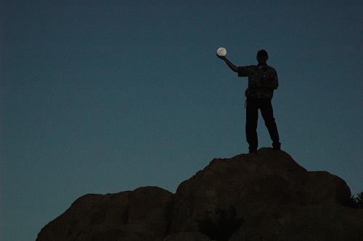
Size Constancy-Moon Illusion

Slide 32
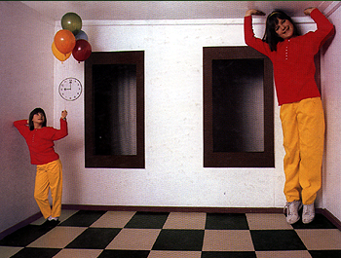
Ames Room
https://www.youtube.com/watch?v=gJhyu6nlGt8

Slide 33
Perceptual Adaptation
Ability to adjust to an artificially displaced or even inverted visual field
Humans can adapt to these situations (displacement goggles)

Slide 34
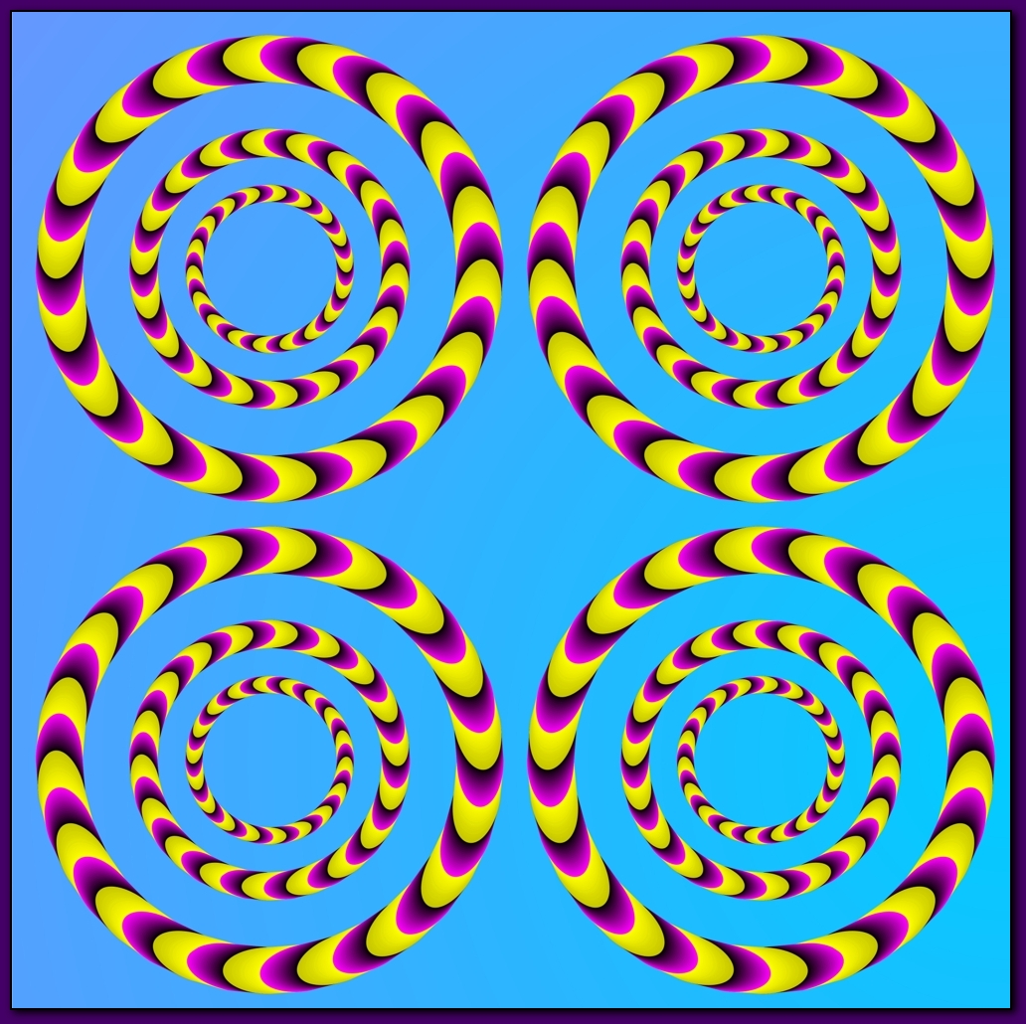
Optical Illusions

Slide 35
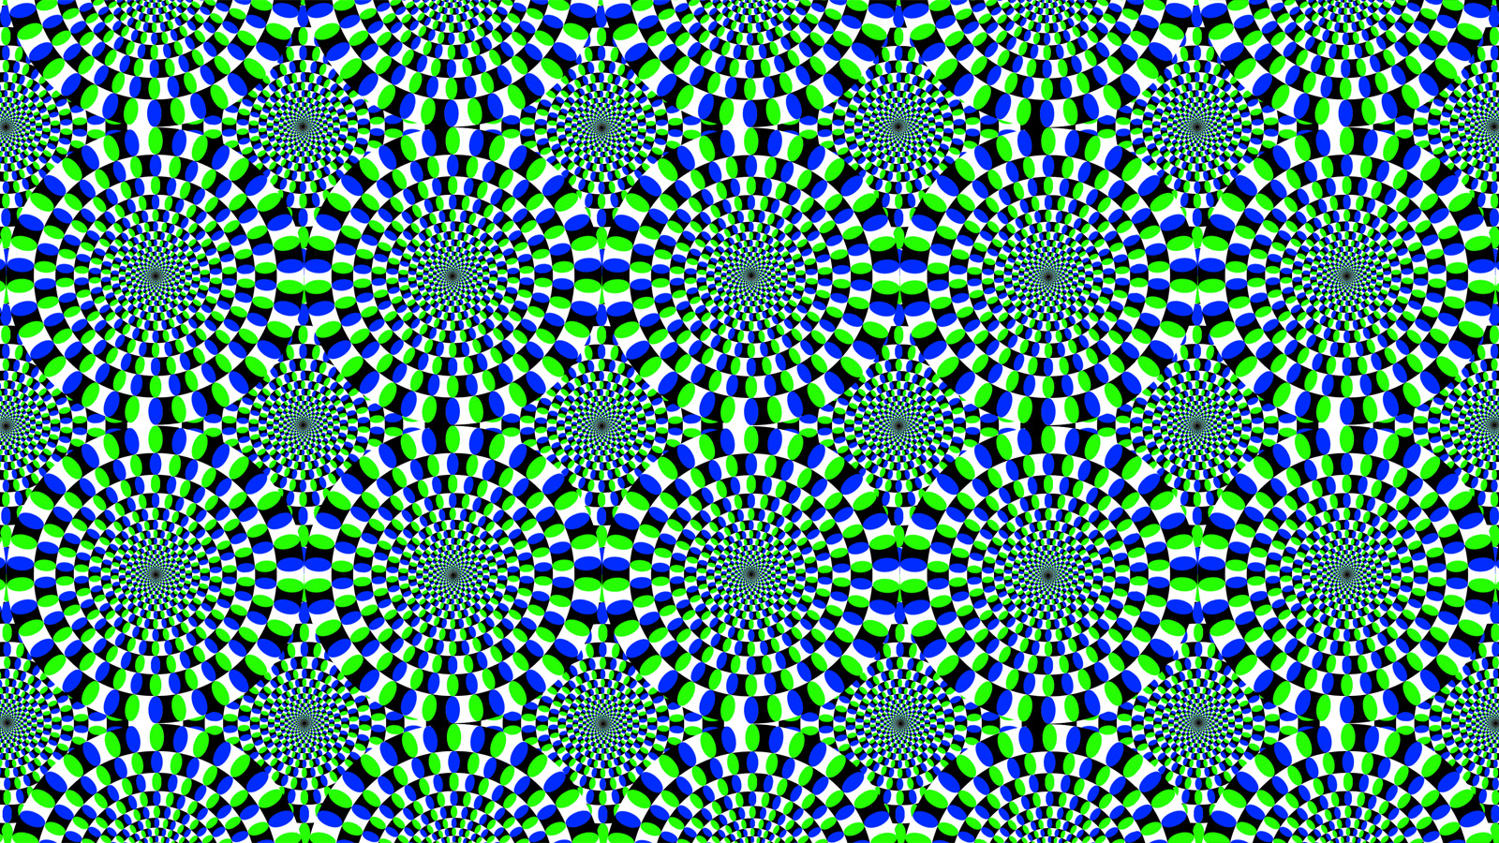

Slide 36
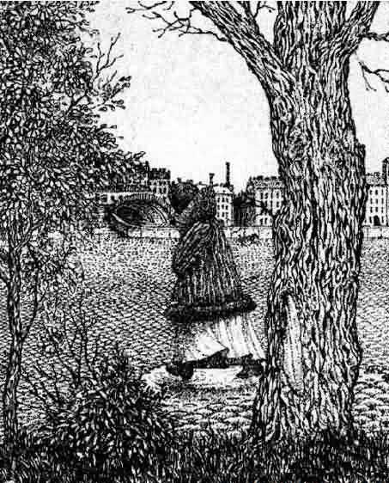

Slide 37
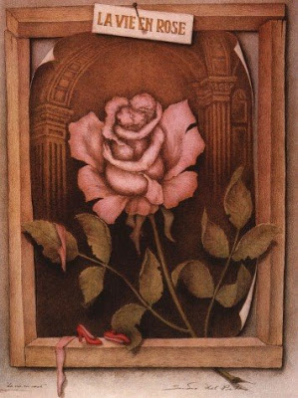

Slide 39
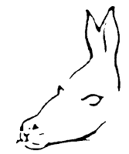

Slide 40
Hermann Grid

Slide 41
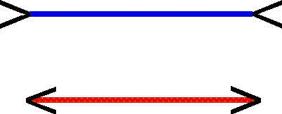
Muller Lyon Illusion

Slide 43
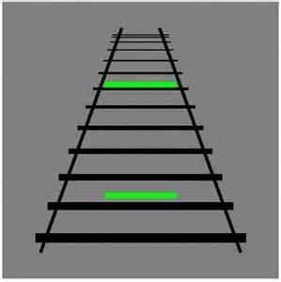
Ponzo Illusion

Slide 44
Spinning Dancer
http://psychology.about.com/od/sensationandperception/ig/Optical-Illusions/spinning-dancer-illusion.htm

Slide 45
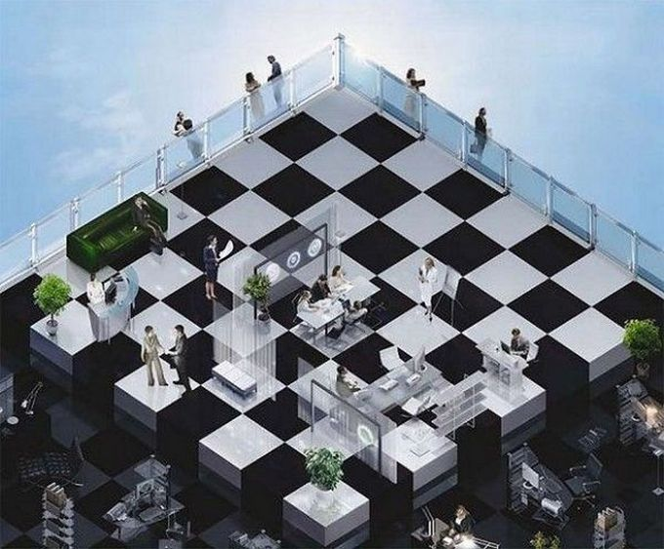
Impossible Figures

Slide 46
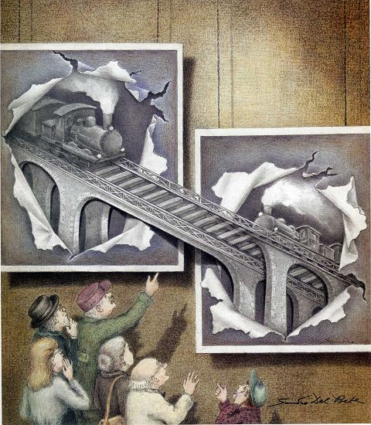

Slide 47
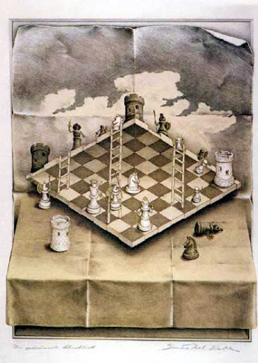

Slide 48
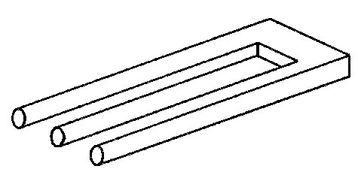

Slide 49
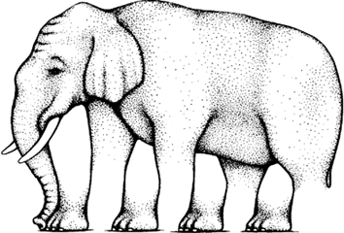

Slide 50
Illusion Gallery
http://dragon.uml.edu/psych/

